Slide 1
Textbook Transformation Grants: Grant Procedures

Slide 2
Communications (review)
Jeff Gallant: Program Manager, Affordable Learning Georgia Board of Regents, USG
Ongoing point of contact for Service Level Agreements
Ongoing point of contact for implementation assistance and compliance reporting. Including help or referral on questions about content, materials, open licensing, etc.
Jeff.Gallant@usg.edu
Email is quicker and more efficient than my office phone!

Slide 3
How Funding Works: Not Your Typical Grant
Funding is not a direct stipend to the team members
Goes to the institution to cover the team member’s time (salary/release time/overload/replacement coverage), project expenses including related department needs, and travel expenses.
Funding will be released to the sponsoring institutional office in two parts: 50% on return of the USG-drafted Service Level Agreement (SLA) with the original or modified proposal serving as the statement of work, and 50% on submission of the final report.

Slide 4
Why?
Gives maximum flexibility to the institution and the team in terms of how many people and what types of skills are needed, amount of compensation vs. replacement of teaching load, and timing in terms of semesters of preparatory work vs. semesters of adoption.
50%/50% further ensures that you have the resources you need to complete the project, and that the project will be completed by the Final Report deadline.

Slide 5
Contact Your Business/Grants Office!
The proposing team should coordinate as necessary with their departments and institutional sponsors to determine how to handle the distribution, including amounts, release time/overload/salary/replacement as well as semester(s).
Your business/grants office needs to know the following:
These grants, while competitively earned, are essentially special allocations of state funds for creation of affordable learning resources. These grants are not the same as federal grants where indirect costs are considered a part of the grant costs. Direct costs, such as salaries, fringes, and supplies are fine.

Slide 6
Service Level Agreements
Pending signatures at USG
Will be sent to project team lead as indicated in confirmation form with instructions, basically:
Acquire signatures as required by your institution (if there is a designated signature authority) as well as your department/unit sponsor (who submitted your letter of support, where funds will be sent)
You will need to coordinate with your business office (our experience has demonstrated this in the previous rounds. It seems like on most, if not all campuses, invoices must be issued by the business office. If you have a grants office you may need to coordinate through them with the business office.
We recommend that you try to find out what contacts you need to inform about your award and what processes need to happen during this time in which the SLA’s are still pending; this will facilitate things down the road.
Return to USG with an invoice in the amount shown on the SLA, with directions on department/unit where payment is to be sent
On receipt by USG, 50% of funds will be disbursed by Business Office
Remaining 50% on receipt of final report
Grant Procedures

Slide 7
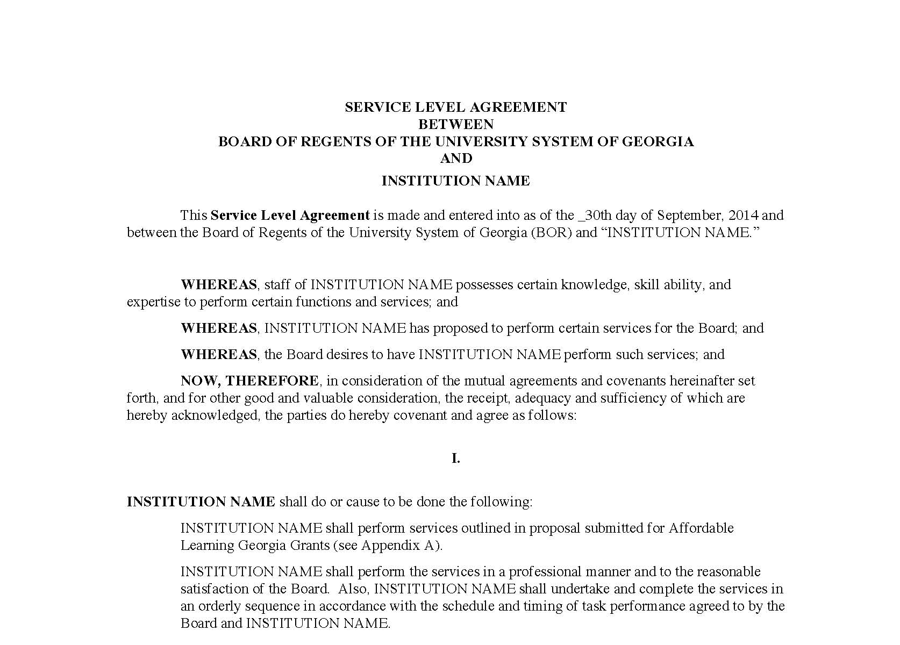
Service Level Agreement (SLA)
“Boilerplate” intergovernmental legal document ensuring that:
We fund the work in the Statement of Work, which is your proposal, and
Your institution ensures the work is completed by the deadline
Foundational document for all Textbook Transformation Grant funding
Includes deadlines (ensure that your Final Semester is correct!)

Slide 8
Steps: From SLA to Funding
SLAs drafted by Jeff
SLAs distributed to Project Leads with detailed instructions
Project Leads read the SLA and forward to appropriate business or grants office
Signatures obtained by business office
SLA and the invoice for full amount sent to Jeff in one email
Jeff enters signed documents into online system for Board of Regents approvals and signatures
Funds distributed from USG business office to institution 50% now, 50% upon receiving Final Report
Jeff is point of contact for SLA status

Slide 9
This is new!
Rounds 1-5 have been done through a paper system that the USG offices have had in place. All procedures and inquiries were done through email. They’re just now starting to use an online platform. (Yes, in 2016.)
These changes should:
Speed up the entire process
Provide Jeff with more transparency and allow him to give an accurate update on SLA status at the BOR

Slide 10
Steps: From SLA to Funding
Ensure that you are in communication with your business/grants office as soon as possible and know where to send the SLA.
I cannot start any Board of Regents-side approvals until I have the signed SLA sent back to me with an invoice from your institution.

Slide 11
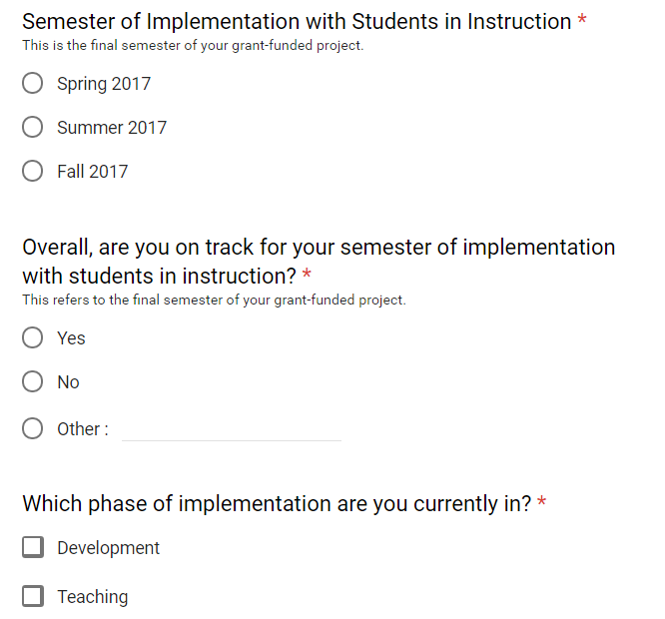
Semester Status Report
Report is an online form
Multiple-choice & short paragraph questions
Focused on project being on track for implementation in your final semester

Slide 12
Final Report
Multiple Documents:
Word Document with narrative section
Includes highlights from qualitative and quantitative measures
Will be shared with public
Syllabus with links to all materials, organized by day/unit/etc., with learning outcomes stated
File with all qualitative/quantitative data
Includes measures of impact on student success / RPG
Qualitative measures, surveys, interviews
Will not be shared with public
High-Resolution photograph of team, students, or both
At least 800x600 pixels (width x height)
Most smartphones take photos at a larger size than this
No pasted-together headshots
Will be shared with public

Slide 13
Required Reporting
Timeline:
Each semester, submit a status report, including this semester, Fall 2016.
If it is not your final semester of instruction, submit a Semester Status Report at the end of the semester.
If it is your final semester, submit a Final Report.
All report links will be on the Information for Round Seven Grantees page, which will be emailed to you via the listserv tomorrow.

Slide 14
Upcoming Reporting Deadlines
Fall 2016: December 23, 2016
Spring 2017: May 26, 2017
Summer 2017: August 11, 2017
Fall 2017: December 22, 2017

Slide 15
What is “implementation?”
Identification, review, selection, and adoption/adaptation/creation of the new course materials.
Course and syllabus instructional design/redesign necessary for the transformation.
Activities expected from each team member and their role(s): subject matter experts, instructional designer, librarian, instructor of record, et al.
(Basically, everything before the Final Semester.)

Slide 16
Planning Your Measures
Need to plan and consider how to capture/collect data that shows impact on student performance
Need to plan and consider how to capture/collect qualitative evidence from students about their experience and satisfaction with the materials
Consider IRB approvals if necessary
Every institution’s IRB procedures are different!

Slide 17
Questions?

