Slide 1
Kickoff Meeting for Round 18 Grantees
Jeff Gallant, Program Director, Affordable Learning Georgia
Tiffani Reardon, Program Manager, Affordable Learning Georgia

Slide 2
An ALG Quick Look
Screenshare Tour with Tiffani

Slide 3
15 Minute Break

Slide 4
R18 Breakout Groups: Introduce Yourselves!
Transformation Grants with Jeff
Continuous Improvement Grants with Tiffani

Slide 5
Breakout Groups (45 min)
Go around the group and talk about your project. Each team should discuss the following:
What your project is (general overview)
What kinds of materials you are planning on using
What your timeline and process looks like
What parts of your project you are unsure about or want feedback on
After each team explains their project, the group should discuss together:
What ideas you have to contribute to their proposal
What feedback you can provide
We’ll come back together for 15 min at the end to talk about some of the ideas you all came up with.

Slide 6
R18 Breakout Groups (15 min)
Back with everyone, tell us about the ideas your group came up with.

Slide 7
15 Minute Break Come back at 3:25

Slide 8
Affordable Materials Grants: Grant Procedures

Slide 9
How Funding Works: Not Your Typical Grant
Funding is not a direct stipend to the team members.
Funding goes to the institution to cover the team member’s time (salary/release time/overload/replacement coverage), project expenses including related to department needs, and travel expenses.
Funding will be released to the sponsoring institutional office in two parts:
50% on return of the USG-drafted Service Level Agreement (SLA) with the original or modified proposal serving as the statement of work
50% on submission of the final report

Slide 10
Why?
Institutional disbursement gives maximum flexibility to the institution and the team in terms of how many people and what types of skills are needed, amount of compensation vs. replacement of teaching load, and timing in terms of semesters of preparatory work vs. semesters of adoption.
50%/50% disbursement further ensures that you have the resources you need to complete the project, and that the project will be completed by the Final Report deadline.

Slide 11
Contact Your Business/Grants Office!
The proposing team should coordinate as necessary with their departments and institutional sponsors to determine how to handle the distribution, including amounts, release time/overload/salary/replacement, as well as semester(s).
Your business/grants office needs to know the following:
These grants, while competitively earned, are essentially special allocations of state funds for the implementation and creation of affordable learning resources.
These grants are not the same as federal grants where indirect costs are considered a part of the grant costs. Direct costs, such as salaries, fringes, and supplies are fine.
This is why we had you discuss your proposal with your grants or business office before submitting to us!

Slide 12
Service Level Agreement (SLA)
“Boilerplate” intergovernmental legal document ensuring that we fund the work in the Statement of Work, which is your proposal.
Common Dates:
“Entered Into” date: Date SLA is sent
All Start Dates are October 30, 2020 (Kickoff Date).
Check to make sure your end dates are correct when this arrives:
Summer 2021 End Date: August 16, 2021 (Final Report Deadline).
Fall 2021 End Date: December 20, 2021 (Final Report Deadline).

Slide 13
Step 1: Getting the Institutional Signatures
ALG drafts SLAs
ALG distributes SLAs to Project Leads, limited time to check the dates and budget
ALG distributes SLAs to Business/Grants Offices for institution signatures
New in Round 18: Using DocuSign. Offices can forward to the correct signatories using it.
Business/Grants Offices get SLA signed and send it back to us

Slide 14
Step 2: Getting BOR Signatures (The Opaque Zone)
ALG submits signed SLAs to the BOR Business Office
BOR Business Office sends to Legal, Legal signs
Business Office creates PO and sends to ALG
ALG sends fully-executed SLA to Business/Grants Offices and Leads
We can check with the Business Office on where something is in the system, but we can’t check with Legal on their signature status. If something’s odd or held up, we will contact the Business Office, and they will contact Legal, because they have more technical information about the status of the contract.

Slide 15
Step 3: 1st and 2nd Invoices
Now that SLA is fully-executed, Institution’s Business/Grants Office sends 1st Invoice
ALG sends the invoice and a signed payment request to Accounts Payable
Their processing usually takes 1-2 weeks
Accounts Payable sends first payment to institution through ACH
The person receiving ACH payments is the only one who will see it at first
ACH payments are sometimes lumped together from BOR
At the end of the grant project, institution sends the final invoice once final report is sent. Final Payment Request leads to the final payment to institution through ACH.

Slide 16
Semester Status Report
Report is an online form
Includes multiple-choice & short paragraph questions
Focuses on project being on track for implementation in your final semester
Is always available via link on the Grants Information Center

Slide 17
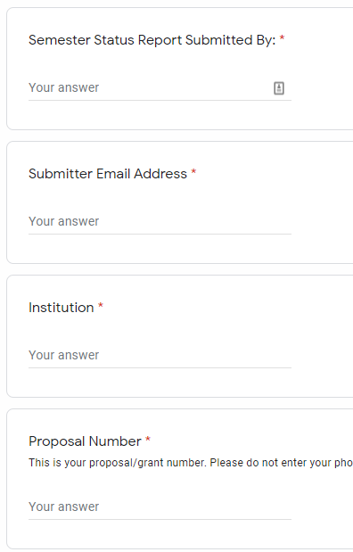
Semester Status Reports

Slide 18
Semester Status Reports

Slide 19
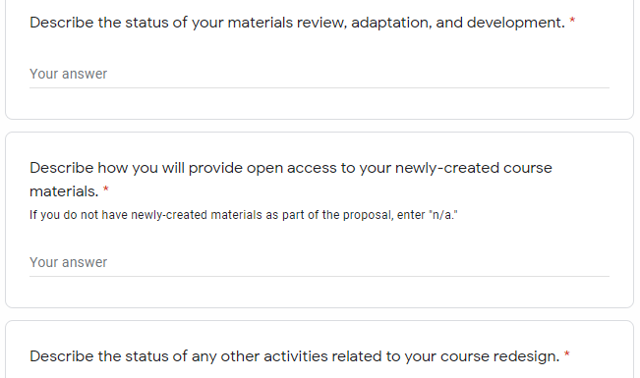
Semester Status Reports

Slide 20
Final Report
Is only submitted at the end of the final semester of the project
Is always available from the Grants Information Center: http://affordablelearninggeorgia.org/about/grants_info/

Slide 21
Final Report Walk-Through

Slide 22
Final Report Submission
Check the Grants Information Center for the link: http://affordablelearninggeorgia.org/about/grants_info/
Five items:
Word document
All data (can use a .zip folder if more than one file)
Syllabi (same here, .zip works well)
Photo (team or class) (optional)
2nd invoice (if possible, work with your offices beforehand to make sure this is ready)

Slide 23
Final Report: Sending Materials
If all of your materials have a small combined file size (usually under 30MB), you can send them directly through the Final Report. Just combine the files in a .zip and send them over.
If that doesn’t work:
Send them in a Google Folder or Dropbox Folder
Host them on your campus webpage and link us to them in the Final Report
Attach them in an email (filesize limits apply here)
The method doesn’t matter so much. We’ll host them after that.

Slide 24
Photos (Optional)
If you are submitting a team or class photo, please do not send separate headshots.

Slide 25
Upcoming Reporting Deadlines
Fall 2020: December 23, 2020
Spring 2021: May 17, 2021
Summer 2021: August 16, 2021
These will be on the Grants Information Center. Please bookmark the page! We will also email the link later.
https://affordablelearninggeorgia.org/about/grants_info/

Slide 26
Listserv
You were added to the ALG-GRANTEES-L Listserv with all standard-scale, large-scale, and mini- grantees.
General emails from us on the listserv will not have brackets.
Emails for only you will be [R18], [R18 CI], or [R18 Transformation].
As always please be careful when replying to the entire listserv.
If you have any personal questions, please let us know as jeff.gallant@usg.edu and/or tiffani.reardon@usg.edu.

