Slide 1
CIDI Accessibility Training
Presenter: Valerie Morrison, Ph.D.
E-Text Manager, CIDI

Slide 2
CIDI’s Products and Services
E-Text Services: we transform textbooks, supplements, journals, brochures, manuals – basically any print material – into a variety of accessible electronic formats, including PDF, DOC, EPUB, DAISY, HMTL, and PowerPoint files.
Braille Services produce timely, cost-effective, high-quality electronic and embossed Braille and custom tactile graphics.
Captioning and Described Media Services make classroom lectures, meetings, labs, or webinars fully accessible for deaf or hard-of-hearing and provide post-production transcripts, captioning, and described video.
Certified Assistive Technology Team conducts on-site and remote assessments, and offer demonstrations, training, and assistive technology for education, work, and daily living environments.
ICT Accessibility Compliance Consultations focus on the accessibility needs of organizations, offering technical assistance, customer support, and evaluation of overall website accessibility.

Slide 3
Goals for Today’s Presentation
Why accessibility matters
How to create accessible documents
Checking web resources for accessibility
How to write alternative text for images
Captioning and transcripts for videos

Slide 4
Why Accessibility Matters

Slide 5
Defining Accessibility
Conversational accessibility (to understand):
Can someone access the difficult language in this journal article?
Will fans find Westworld inaccessible because it has such a complicated plot?
Physical accessibility (to get in):
Can someone access the building with a Buzzcard or do we need to be let in?
Will I be granted access to Canvas to view our discussion posts?
Digital accessibility (to meet accessibility guidelines):
Can someone navigate through this document with accessible headings?
Will images be described in this file with accessible alternative text?

Slide 6
Accessibility on the Rise
New Accessibility Legislation passed here in the U.S., Canada, and in Europe:
Accessible Instructional Materials Bill Reintroduced (article) (text of the previous version of the bill)
Bill C-81 Passes in Canada
The European Accessibility Act is Approved by European Parliament
Game Accessibility Options Becoming the Norm

Slide 7
Who Uses Accessible Media
The audience for Accessible Media is not just people with disabilities. It is far larger than you would imagine:
Individuals who are blind, or experience color blindness or low vision
Students with mobility issues who cannot hold a textbook
Students with motor disabilities who cannot turn pages
The Deaf and Hard of Hearing Community
Students with learning disabilities such as dyslexia or ADHD
Students with head injuries, trauma, or cognitive disabilities
Auditory learners
Aging population

Slide 8
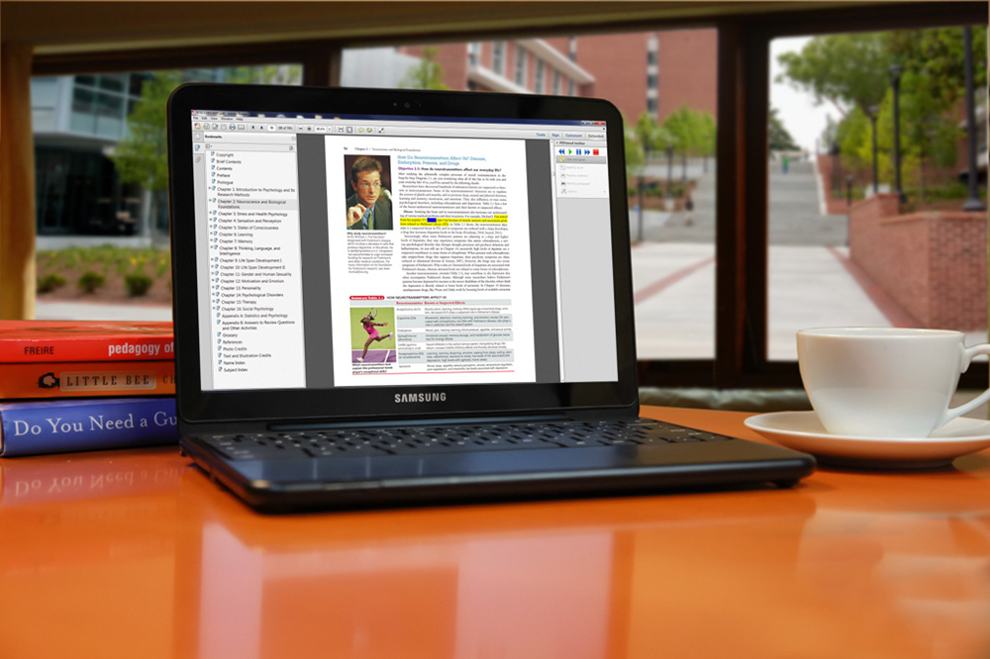
What Needs to Be Accessible?
Ideally, everything in an educational environment or posted online should be made accessible:
Textbooks and Course Materials
Course Syllabi and Exams
Handouts
Courses Websites
Readings and Course Packets

Slide 9
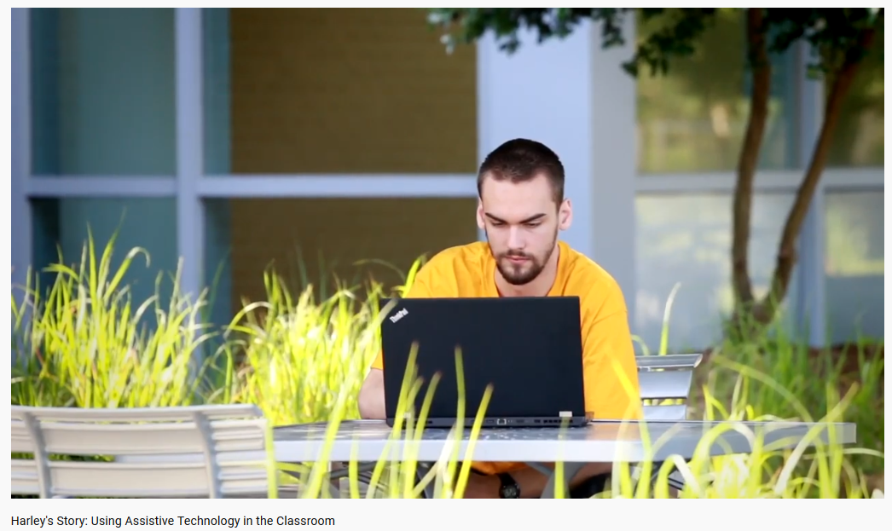
Assistive Technology in Action
Notes:
Harley’s Story: Using Assistive Technology in the Classroom: https://www.youtube.com/watch?v=-IiRCFxjB3Y

Slide 10
Creating Accessible Documents

Slide 11
3 Tips for Greater Accessibility
Keep these 3 ideas in mind for greater accessibility across all programs:
1. Is my content easy to navigate?
Have I created headings and bookmarks for easy navigation?
2. Are my design choices accessible?
Have I chosen fonts, colors, and backgrounds that are easy to discern?
3. Are my images clearly and fully described?
Have I written alt text descriptions and captions for my images?

Slide 12
Adding Headings for Navigation
Add Headings to Microsoft Word Docs for easy navigation and to mark important chapters or subsections.
Highlight a word or line in your document and select a Heading Level in the Styles group on the Home Ribbon.
To view all Headings within your document, click on the View Tab and check the Navigation Pane box.

Slide 13
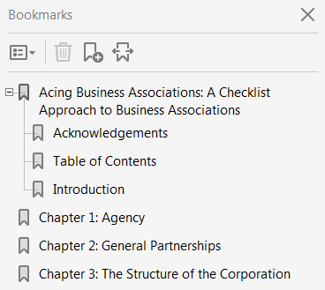
The Bookmarks Pane in Adobe
Highlight text and right click, or press CTRL + B to create bookmarks.
To adjust the hierarchy, drag them up and under the “parent bookmark” so they appear indented.
You can edit the text of a bookmark, to include the word “Chapter” for instance.

Slide 14
Accessible Organization
Organize material with clear headings and logical structure.
Highlight text to ensure proper reading order where the main body text is not interrupted by footnotes, images, captions, or tables.
Add headings and bookmarks for clear navigation.
Use headings to create an accessible table of contents if possible.
Explain all acronyms, symbols, and abbreviations for your audience at the top of the page, not the bottom.

Slide 15
Accessible Design
Font size (12 pt. minimum).
Sans serif fonts are best (Calibri, Arial, Verdana, Helvitica, Geneva).
Avoid large amounts of italicized, bold, underlined, or capitalized text.
Do not rely on color coding alone to convey meaning.
Color contrast should reduce eye strain (yellow text on black background is most accessible).
If you must use graphics, try to convey the meaning in text as well, and always provide a caption and alt text description.

Slide 16
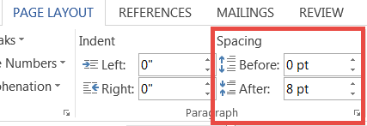
Accessible Spacing
Only adjust spacing using page layout, line spacing, section breaks, and ruler. Do not hit enter or tab repeatedly to create white space.
Create columns with Microsoft Word’s formatting tools, not by tabbing or creating a makeshift table to arrange text.
Inserting section breaks and adjusting your margins can help you change the layout of your page if necessary.

Slide 17
Checking for Accessibility

Slide 18
Assessing Web Resources
Key accessibility features to look for include:
Clear navigation with Headings or Bookmarks
Accessible text that can be highlighted
Text that can be selected in a logical reading order
Alternative text description for all images
Note: Always check materials after uploading them to a learning platform to make sure they are still accessible.

Slide 19
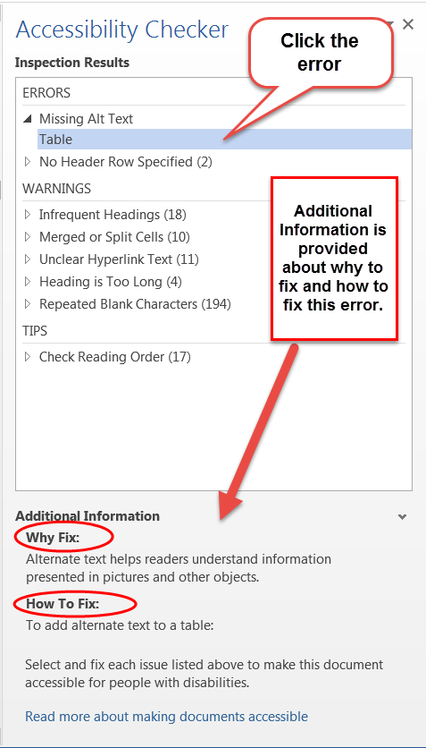
Accessibility Checker in Office
To check Microsoft Word files for accessibility, save your document as a .docx file. For a PowerPoint presentation, save as a .pptx file.
Go to the Review tab and select Check Accessibility. Note: If you are working with an older version of Office, click on the File tab and click on Check for Issues and select Check Accessibility.
The accessibility checker will open in a separate pane and list all errors and warnings with links to where they occur in the document.
Additional information appears below, instructing you on why this might cause a problem and how to fix the issue.

Slide 20
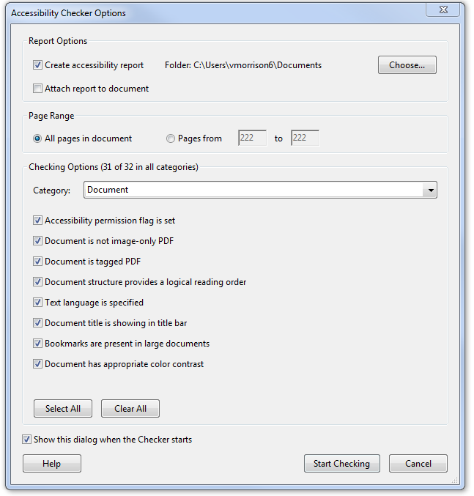
Accessibility Report in Adobe
To check PDF files for accessibility, generate an Accessibility Report in the Accessibility Tools options of Adobe Acrobat.
Click on “Full Check” to open a list of things you’d like your check to include, such as figures missing alt text, missing bookmarks, errors in reading order, color contrast, not having a language selected, etc.

Slide 21
Alternative Text

Slide 22
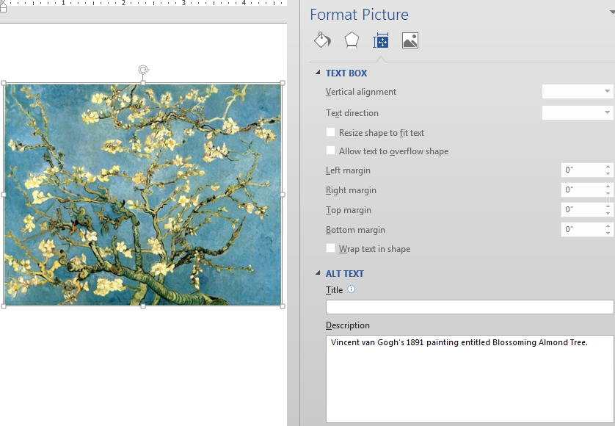
Alternative Text Descriptions
All images in a document should be fully described using proper capitalization, grammar, spacing, and punctuation.
To add alternative text:
Right-click on the image.
Choose Edit Alt Text.
Note: In older versions of Office, choose Format Picture. Select Layout Properties icon. Click on the Alt Text link.
Type in the description field.
Do not use hard line breaks.

Slide 23
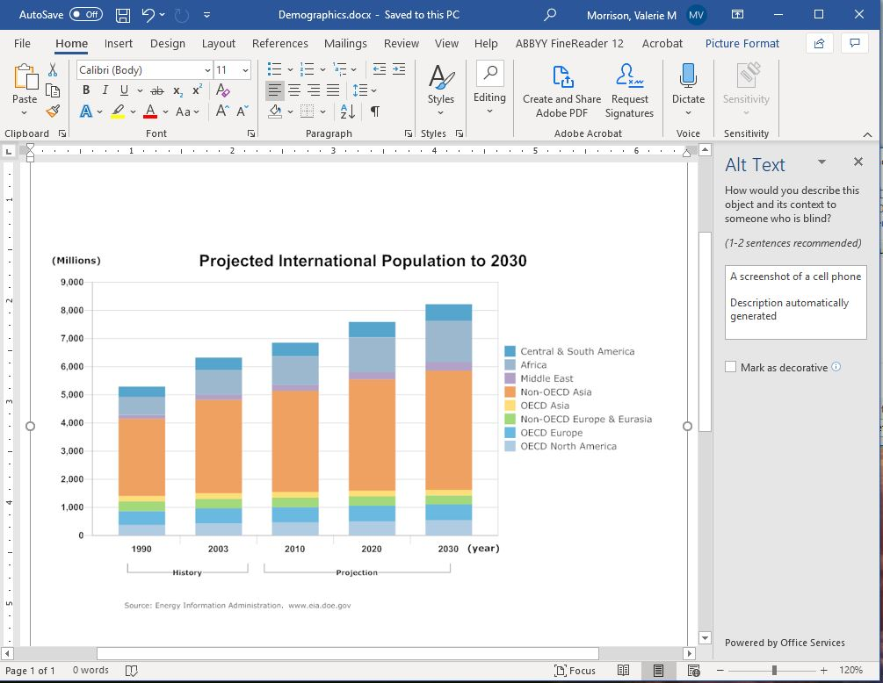
Automated Alt Text
Microsoft now autogenerates alternative text by default. To disable this feature in both Microsoft Word and PowerPoint:
Click on File
Click on Options
Select Ease of Access on the left
Scroll down and uncheck “Automatically generate alt text for me.”

Slide 24
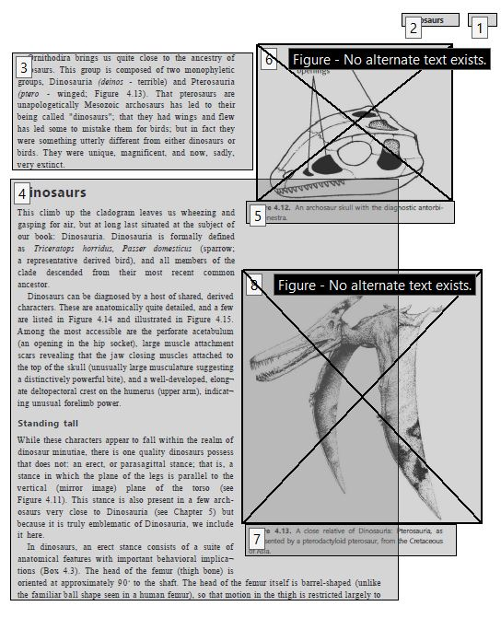
Adding Alt Text to a PDF File
If you need to add alt text to an image in Acrobat, first click on Tools, and select Accessibility.
Select the Reading Order tool and scroll through your file looking for images. Right click to add alt text.
Running the accessibility report will also flag these images and allow you to click on them and add alt text.

Slide 25
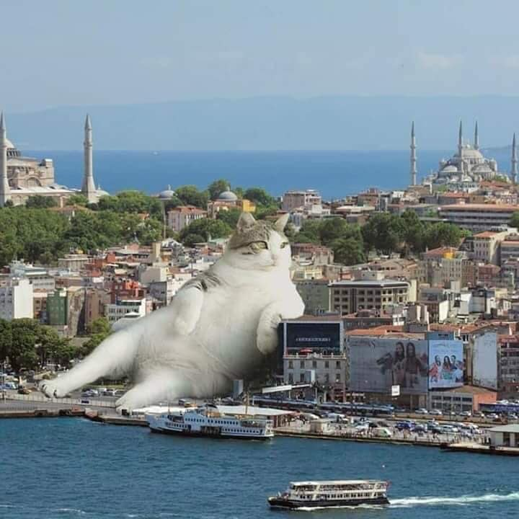
How to Describe Images
First summarize what you see in one general informative sentence.
Keep your description neutral and informative.
Use proper grammar, spelling and punctuation.
Avoid acronyms and symbols.

Slide 26
How Much Is Too Much?
Best practice is 125 characters, or the length of a Tweet.
The default setting for JAWS screen reading software pauses after 250 characters.
However, depending on purpose or audience, alt text can get quite long.

Slide 27
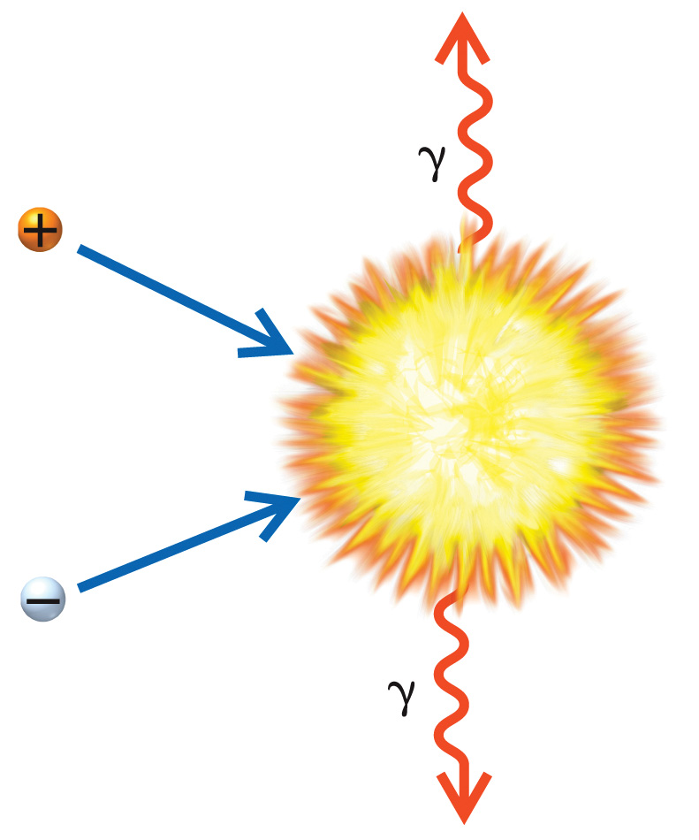
Focus on Meaning
Avoid the common mistake of spending your time describing the appearance of symbols.
Instead, focus on meaning, as that’s the most important information to relay.
Example: In this image, you would want to avoid describing “a ball labeled with a plus sign” and instead you should call it “a positron.” Avoid describing “a squiggly arrow labeled with a weird y” and instead call it “a gamma ray.”
Notes:
Describe meaning not appearance.

Slide 28
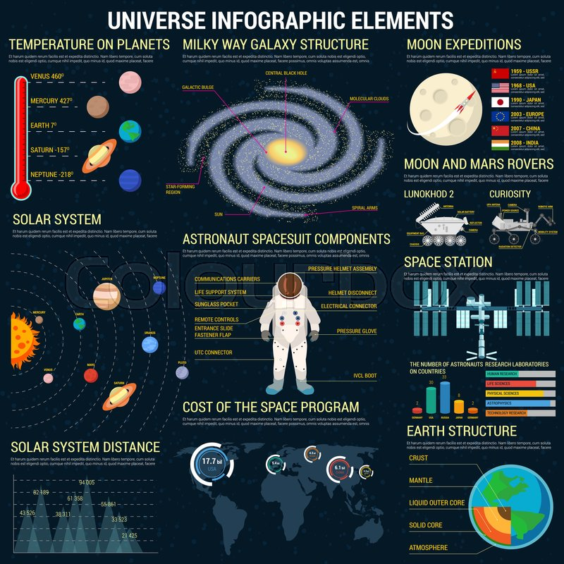
Consider Cognitive Load
Cognitive load, also referred to as Auditory Fatigue, is something to consider when writing alternative text, so that you don’t overwhelm the listener.
If there is too much information contained in an alt text, it is best to shorten the alt text and add a table or list to accompany the image. This table or list can hold the information in a more logical way.
Keep your alt text descriptions as concise as possible and edit out repetition. Also try to group items so your description is easier for someone to process.

Slide 29
Captioning and Transcripts
Notes:
Define Cognitive Load: The amount of mental effort required to do an activity.
Imagine it as the number and weight of things you carry. If someone hands you a piece of information, and then another, and then another, eventually you can’t hold any more in your arms.
Reducing complexity allows someone to move something from working memory to long term memory.

Slide 30
Captioning for Classes and Videos
CIDI can provide live remote captioning for classroom sessions, meetings, conferences, and events such as commencement ceremonies.
Create accessible and high quality captions for videos.
Provide accessible transcripts of videos.
Provide Audio Description, including initial researching of video content, writing scripts, recording audio with human voice actors, editing audio for clarity, and adding the final audio recordings to video content.

Slide 31
Audio Description
“Audio Description involves the accessibility of the visual images of theater, television, movies, and other art forms for people who are blind, have low vision, or who are otherwise visually impaired... Audio Description is commentary and narration which guides the listener through the presentation with concise, objective descriptions.” Source: The American Council of the Blind.

Slide 32
Audio Description Example
An older man holds an air horn outside of a home. Text reads “Jeff Foster: Tired of Birds.” The Weather Channel logo appears in the lower right.

Slide 33
Have Further Questions?
Contact our Customer Support Team by phone (404) 894-7756 or by email cidi-support@design.gatech.edu

