Slide 1
Textbook Transformation Grants: Kickoff Meeting
February 24, 2019
Middle Georgia State University
Round 16
Notes:
Welcome to kick-off! Congratulations on receiving a round 16 Textbook Transformation Grant; we’re excited to work with you to make your courses more affordable for your students.

Slide 2
Coordinators and Presenters
Jeff Gallant: Program Director, Affordable Learning Georgia
Tiffani Reardon: Program Manager, Affordable Learning Georgia
BJ Robinson and Corey Parson: University of North Georgia Press
TBD: OpenStax, Rice University
Valerie Morrison: Center for Inclusive Design and Innovation, Georgia Tech
Notes:
My name is Tiffani Reardon, I am ALG’s new program manager (been here for less than a month!). I’m new working for ALG, but I’m not new working with them! In fact, I have been in your seat several times at these kick-offs, going all the way back to round 3.
I’m going to lead us through this first part of our day, and then you’ll hear from our program director, Jeff Gallant, later this morning. During lunch, you’ll hear from BJ Robinson and Corey Parson from the University of North Georgia Press and from ____ from OpenStax. Finally, after lunch, you’ll hear from Valerie Morrison at Georgia Tech’s Center for Inclusive Design and Innovation.

Slide 3
Directions
Restrooms: Turn left out of 212, walk down the hallway, on your first right. If you see classrooms, you've walked too far!
You can always leave for the restrooms! No worries!
Lunch Table: Turn right out of 212. It's across from the registration desk.
Food in 212: Please pick it up whenever you want!
Notes:
Before we get started, housekeeping.
We are in room 212. If you come out the doors, turn left, and then turn right, you’ll find the restrooms. If you see classrooms, you’ve gone too far! Don’t worry about getting up during presentations. Feel free to leave for the restroom any time.
If you come out the doors and turn right, you’ll find the lunch table across from the registration desk. At lunch, you go out there, grab your food, and come back for the lunch presentations.
There is also food right here in 212, if you find yourself feeling peckish. Feel free to get up any time to grab a snack, coffee, tea, or water.

Slide 4
Agenda
9:00-9:50
Introductions and Open Education
10:00-10:50
Grant Processes and Licensing
10:50-11:00
Break
11:00-12:00
Breakout Groups
12:00-1:00
Working Lunch with UNG Press and OpenStax
1:00-2:00
Accessibility with CIDI
2:00-2:10
Break
2:10-2:40
Hosting
2:40-3:00
Wrap-up and Q&A
9:50-10:00
Break
Notes:
So, we’re going to start today off with some introductions and an overview of open education, with me.
Then we’ll have a 10 minute break before we hear from Jeff on the grant process and open licensing.
We’ll have another 10 minute break, and then we’ll have some break-out groups where you all will have the chance to collaborate and discuss your projects with other teams doing the same type of work.
After breakout groups, we’ll head to the lunch table and come back to hear from the UNG Press folks and then OpenStax.
After lunch, we’ll hear from Valerie on accessibility, followed by another 10 minute break.
Finally, Jeff and I will talk about hosting options and we’ll discuss your projects and ideas for hosting.
And then we’ll end the day with a quick wrap-up and some time for Q&A.
You all should have a copy of the agenda, but if not, you should have it in your emails.

Slide 5
Objectives: Why are we here?
Gather information for a successful project
Meet and collaborate with your grant cohort
Raise and discuss issues and concerns
Notes:
So, why are we here? Why are we having this kick-off meeting?
We’re here so you can gather information for a successful project. Today you’ll learn about open education, open licensing, accessibility, hosting, and other resources, and these things will all be essential to the success of your project.
We’re also here so you can meet and collaborate with the other grantees from across the USG. It helps to get to know the people doing the same kind of project as you so you can bounce ideas of one another, and honestly to also just know that you aren’t alone in this big project you’ve taken on. Let’s see a show of hands, and look around as you answer these questions so you can see all the other projects going on this round.
Who all is adopting an open textbook?
How about curating open resources?
Creating new resources or a new textbook?
Creating ancillary materials like quizzes, powerpoints, etc.?
Scaling up the use of an open textbook or resources in your department?
Finally, we’re here so you can raise your issues, questions, and concerns about the project so we can all discuss them together. The goal is for you to leave here today feeling like you either have everything you need to get started OR know where to find what you don’t have.

Slide 6
Introductions
Who are you? Name, position, institution?
What's your project and why are you doing it?
What’s your favorite book?
Notes:
But first, introductions. We’re going to go around the room and have everyone tell us your name, position, and institution, what your project is and why you are doing it, and just for fun, what your favorite book is.
*Everyone else first
As for me, my name is Tiffani Reardon, and I am the program manager for Affordable Learning Georgia. I’ve had a few grant projects over the years, but the most relevant one to me and my subject area is Open Technical Communication, in which I and a team of 4 faculty at Kennesaw State developed a new open textbook for our technical writing courses. It’s been live since 2016, but it’s a constantly evolving project, so we’re always doing something new with it. And my favorite books are the Harry Potter series—I was raised on them!

Slide 7
Equity in Education
Notes:
So why do we do this? The ultimate goal of making college more affordable is to create equity in education.

Slide 8
Impact of Textbook Costs on Students
Florida Virtual Campus 2018 Survey (n=24,189)
Notes:
According to a survey conducted by Florida Virtual Campus in 2018, approximately 65% of students don’t purchase the required textbook. 64%!
43% of students take fewer courses because textbooks are too expensive, 41% choose not to register for a particular course because the textbook is expensive, 36% of students earn a poor grade because they couldn’t afford to buy the textbook, and 23% of students dropped a course because the textbook was too expensive.
The cost of textbooks has a high impact on students. It requires them to choose between school and basic life needs, and when they choose life (which they should), their education suffers.

Slide 9
What is Affordable Learning Georgia?
A USG initiative to reduce the costs of textbooks to students, therefore contributing to student success, retention, and graduation
A set of programs to support the implementation of more affordable learning materials in the classroom including OER, library resources, and low-cost commercial resources
A one-stop service to help USG faculty and staff understand and identify these resources
Notes:
So what is Affordable Learning Georgia?
It is a University System of Georgia initiative to reduce the costs of textbooks to students, therefore contributing to the student success, retention, and graduation.
To do that, it is a set of programs (like the Textbook Transformation Grant program) to support the implementation of more affordable learning materials in the classroom including open educational resources, library resources, and low-cost commercial resources.
And in support of those programs, it is also a one-stop-shop for USG faculty and staff to understand and identify these open and affordable resources.

Slide 10
Why do grants help?
From our surveys and interactions with faculty, we know that all educational resource adoption requires extra time. OER adoption requires even more time to be successful.
Through more team members and extra time, Textbook Transformation Grants support:
Creation of new OER, revision of existing OER
Curriculum / Outcomes revision and alignment with new no-cost and low-cost resources
Support for training and development
Notes:
So you guys are part of the Textbook Transformation Grant program. How do they help? Well, we’ve found through faculty surveys that any kind of course material/educational resource adoption requires extra time. Adopting open educational resources, however, take even more time.
Textbook Transformation Grants provide grantees with a team, time and resources needed to support the creation of new OER and/or revision of existing OER, curriculum and outcomes revision and alignment with the new resources, and support for training and development.
Jeff is going to talk a little more about how the grant process and funding work in a little bit.

Slide 11
Impact Beyond Savings
Student savings are the main objective of Textbook Transformation Grants, but projects also help other USG faculty through:
Shared Evaluations of Materials (Final Reports)
Shared Sustainability Measures
New OER and New Adaptations / Revisions
Lessons Learned
New Research on Outcomes and Perceptions
Notes:
So, the point of the Textbook Transformation Grants is to save students money. However, there are some other benefits to the USG beyond that.
When you submit your final reports, you are sharing all of that information with all of USG, including your evaluations of materials, sustainability measures, new materials and adaptations of previously existing materials, lessons learned, and new research on the outcomes and students perceptions.

Slide 12
Impact Across the Globe
Over 30,000 downloads in our OER repository are from the Philippines.
Over 20,000 are from India.
Over 9,000 are from Nigeria.
Notes:
In addition to the benefits to students and the USG, these grants and the materials that come out of them are also creating impact across the globe. Over 30,000 downloads from our OER repository are from the Philippines, 20,000 from India, and 9,000 from Nigeria. Other countries are using your OER to benefit their own educations!

Slide 13
Impact, Remixed
26 textbooks in the curated Open Textbook Library have USG faculty authors.
LibreTexts is adding our open textbooks to their collection, making them web-readable and remixable with other LibreTexts works.
Notes:
And, ALG-funded work is being adopted to other repositories, too! The Open Textbook Library has 26 books written by USG faculty authors, and LibreTexts is adding our books to their collections, adding functionality to them, as well!

Slide 14
Open Education: The Methods and the Field
Notes:
So let’s talk about the basics of open education.

Slide 15
Copyright in the Digital Age
Notes:
So, what makes a thing open? It is very much dependent on the copyright permissions of that thing.

Slide 16
Open = Free + the 5R Permissions
Retain
Retain: Keep any open resource. Access does not disappear.
Reuse
Reuse: Use open content in a variety of ways without restrictions.
Revise
Revise: Adjust, modify, or alter the content to fit your students' needs.
Remix
Remix: Combine the content with other open materials.
Redistribute
Redistribute: Share copies with others without restrictions.
Notes:
When a thing is open, it means that it is free and that it gives the 5R permissions:
Retain, permission to keep any resource. Meaning that access does not disappear.
Reuse, permission to use the open content in a variety of ways without restrictions.
Revise, permission to adjust, modify, or alter the content to fit your students’ needs.
Remix, permission to combine the content with other open materials.
And Redistribute, permission to share copies with others without restrictions.

Slide 17
Common Types of OER
Open Textbooks: Open resources that comprehensively cover the standard scope and sequence of an entire course.
Open Ancillary Materials: Materials which supplement the instruction of a course, such as lecture slides, videos, and images.
Open Assessments: Assessments of student learning which are hosted and/or performed in public spaces.
Notes:
A few of the common types of OER are open textbooks, which comprehensively cover the standard scope and sequence of an entire course just like your current textbooks do, except they are open. Many of you are going to be working with open textbooks in some way for this grant.
There are also open ancillary materials, which supplement the instruction of a course, such as lecture slides, notes, videos, and images. These are the instructional content you provide to students outside of the textbook itself.
And then there are open assessments which assess student learning just like your current assessments, except that they are made publicly available. Of course, not everything can be share publicly in this case. You wouldn’t want to share a quiz bank publicly because then students can search and find the answers to their quizzes and exams. But you could provide an avenue for instructors to request that quiz bank from you to use in their courses, and you can always share other graded assignments and activities publicly.

Slide 18
Creative Commons: How Open Works
Creative Commons licenses are legal permissions given to everyone on top of your copyright. They give the 5R permissions with the following restrictions:
Attribution (BY): You must attribute the original work when you make a copy or a new work.
Share-Alike (SA): You must put any works created with this work under the same license.
No Derivatives (ND): You may not alter this work, only copy it. Do not use ND with OER.
Noncommercial (NC): You may not use works made with this work for profit.
Notes:
Creative Commons has provided a back-bone for open education through its licenses which enable open-ness. There are lots of options and combinations of Creative Commons licenses, and Jeff will talk more about licensing later, but the baseline options are:
Attribution, which requires that the work be attributed to the original work and creator.
Noncommercial, which restricts the use of the work to only non-commercial uses, meaning that no one can use it for profit.
Share-Alike, which requires that any new works based on the original must be licensed under the same license as the original.
And No Derivatives, which restricts the user to distribution of the work only—they can’t change it. Licensing your work with ND is not compatible with open-ness because it doesn’t follow the guidelines of the 5Rs, so it’s not an option for these grants, but it’s important to understand it in case you find a resource that has the ND license on it that you want to use in your course.
You want to understand these licenses both from a creator’s perspective and from a user’s perspective. Know what you can do with your work and what you can do with others’ works.

Slide 19
Choosing Your License
Go to
https://creativecommons.org/share-your-work.
Use the Attribution Builder.
View the human-readable License Deed.
Check out the Legal Code
(if you have time).

Slide 20
Beyond Resources: Open and OER-Enabled Pedagogy
Notes:
In recent years, the use of open educational resources has been expanded into a pedagogy.

Slide 21
What is Open Pedagogy? ...good question!
Open Pedagogy as critical pedagogy
OER-Enabled Pedagogy: teaching beyond copyright restrictions
Notes:
Open pedagogy is a critical teaching practice in which we teach beyond copyright restrictions. Through the use of OER and the creation of OER, we can create meaningful engagement and help our students become invested collaborators in their own education.

Slide 22
How Does OER-Enabled Pedagogy Work?
Students learn by doing/making
Copyright prohibits broad categories of creative activity without permissions from a rights holder
Therefore, copyright limits the ways in which students can learn
The 5R’s of OER lift these restrictions
Therefore, students are free to engage in a broader range of activities and, learn in a broader range of ways
Notes:
So how does it work, though?
Well, we know that students learn by doing things, making things, being creative. But copyright can prohibit creativity in connection with certain materials because you need permission from the owner/creator to use that work to create anything else. This need for permission can limit the ways that we can engage students and help them learn.
But hey, the 5Rs of OER, the use of OER, the creation of OER—that lifts the restrictions of copyright! So if we are using OER and the permissions they afford us to engage our students with new and creative activities, we open (see what I did there?) students’ learning possibilities up.

Slide 23
Disposable Assignments
“These are assignments that students complain about doing and faculty complain about grading. They’re assignments that add no value to the world – after a student spends three hours creating it, a teacher spends 30 minutes grading it, and then the student throws it away.
Not only do these assignments add no value to the world, they actually suck value out of the world.”
- David Wiley, “What is Open Pedagogy?”
This Photo by Unknown author is licensed under CC BY-SA-NC.
Notes:
One of the common ways that faculty are implementing open pedagogy is through the transformation of their disposable assignments into what we call renewable assignments.
Disposable assignments are assignments that students complain about doing and faculty complain about grading. They are assignments that (assess learning, sure, but they) add no value to the world—after a student spends three hours creating it, a teacher spends 30 minutes grading it, and then the student throws it away (both physically and mentally). As David Wiley puts it, not only do these assignments add no value to the world, they actually suck value out of it.

Slide 24
Renewable Assignments
Students create new artifacts (essays, poems, videos, songs, etc.) or revise/remix existing OER
The new artifact has value beyond supporting the learning of its author
Students are invited to publicly share their new artifacts or revised/remixed OER
Students are invited to openly license their new artifacts or revised/remixed OER
Notes:
Renewable assignments, on the other hand, are assignments in which we give students the opportunity to both be assessed on their learning AND contribute to the bigger picture. They create new artifacts (like essays, poems, videos, songs, etc.) or revise and remix existing OER.
The new thing they’ve creates suddenly has added value beyond just assessment, and students can take that a step further by publicly sharing their new work and openly licensing it.
Many faculty are having students create supplementary materials for the open educational resources in their classes that can then be used for future classes. The copyright is, and should remain, up to the students, though—you don’t want to and can’t really make them openly license, but you can educate them on the value of it and provide them with the avenue to do so, if they choose.

Slide 25
Finding OER
Notes:
So now that we’re a bit more comfortable with open educational concepts, where do we go from here? How do we get started?
Well the first thing you need to do, if you haven’t already, is find the OER you want to use.

Slide 26
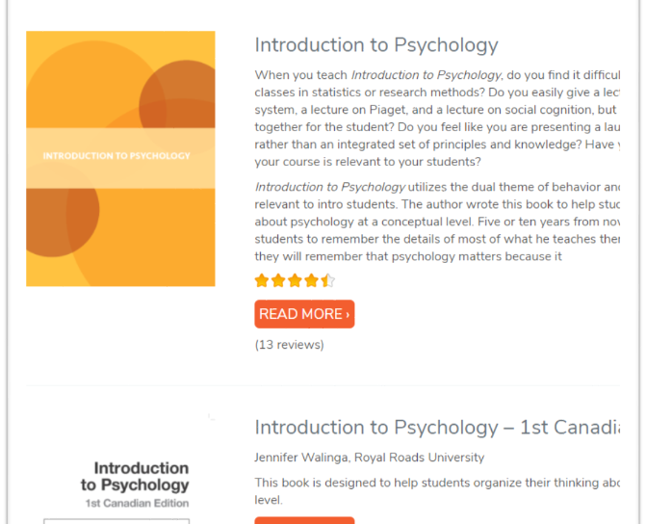
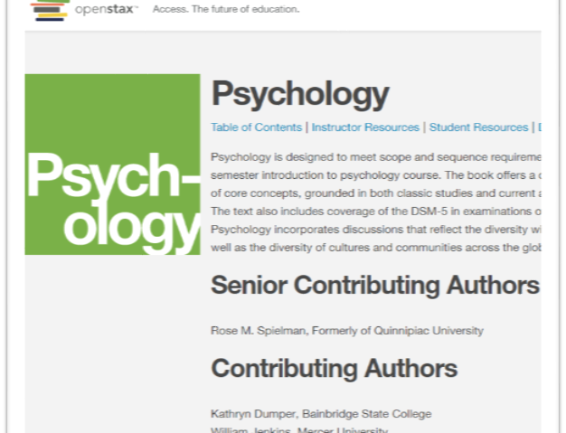
If You Can, Start Small
OpenStax: https://openstax.org/
Open Textbook Library: https://open.umn.edu/opentextbooks/
LibreTexts: https://libretexts.org/
Notes:
And you should start small, if you can. There are some very easy-to-use open textbook libraries out there through OpenStax, which specializes in General Education and STEM courses, and the Open Textbook Library and LibreTexts, which have open textbooks in all different subjects. OpenStax will actually be talking with us for a bit at lunch.
Of course, you can also browse the resources we offer here in the USG. We have an OER repository through GALILEO, and the UNG Press has produced some peer-reviewed open textbooks. They will also be joining us at lunch time.

Slide 27
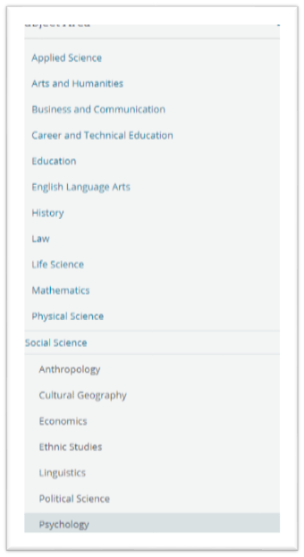
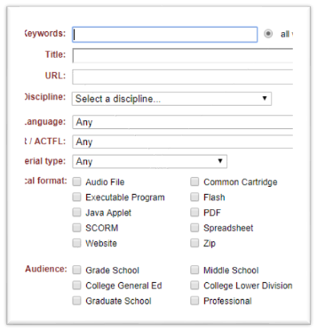
Ending Bigger: What Did I Miss?
OER Commons: https://oercommons.org/
Narrow the results by facets
SUNY OASIS: https://oasis.geneseo.edu/
Narrow the results by type, subject, source, and even reviews
Notes:
Once you’re started small, you can narrow things down a bit using the advanced search tools in the OER Commons and SUNY’s OASIS tool.

Slide 28
Creative Commons Filters are on Common Websites:
•YouTube
•Google Images
•Flickr
Notes:
And there are also Creative Commons filters on a lot of the common websites we use to find content. On Google, YouTube, and Flickr, you can narrow your search down to search for Creative Commons licensing and reuse permissions.

Slide 29
We're Open! Now What?
Have a sustainability plan and stick to it.
Check your links every semester.
Keep any timely materials up-to-date.
Work to improve the adaptability, accessibility, and usability of your resources.
Look toward expanding your resources and/or methods to more sections or more courses.
Notes:
So what do you do when you get to the end of the project? Where do we go from there? Well we’re all educators, and our course materials change all the time to keep up with the times, keep up with new technology, keep up with new developments in the field. Now that you’ve moved away from restrictive textbooks, it becomes your responsibility to maintain currency on your textbooks and resources, as well. So plan for that. Set up a sustainability plan and stick to it.
Check your links, make sure everything is up-to-date, and maintain a continuous improvement plan for your materials. And consider moving beyond this grant. Consider applying OER use to the other courses you teach, consider moving into open pedagogy. Open education is a growing and robust field. Join us.

Slide 30
Keeping Up with OER
Open Education lives on Twitter!
Start by following:
Nicole Allen, SPARC @txtbks
Tanya Spilovoy, SPARC @tanyaspilovoy
David Wiley, Lumen Learning @opencontent
Rajiv Jhangiani, Kwantlen Polytechnic @thatpsychprof
Abbey Elder, Iowa State University @openaccesselder
Amanda Coolidge, BCcampus @acoolidge
(Us, if you want! @jeffwgallant @tiffanikreardon)
You can also join the LibOER listserv
https://sparcopen.org/our-work/sparc-library-oer-forum/
Notes:
And if you’re interested, you can keep up with the open education conversation on Twitter, which in my opinion, is where all of the really rich conversations take place. A few people you can follow are Nicole Allen and Tanya Spilovoy at SPARC, David Wiley at Lumen Learning, Rajiv Jhangiani at Kwantlen Polytechnic, Abbey Elder at Iowa State University, Amanda Coolidge at Bccampus, and of course, us (if you want). There is also a library OER listserv that you can join through SPARC that you can join!

Slide 31
Thank You!
Contributors to these slides:
Jeff Gallant, ALG
Lucy Harrison, GALILEO / ALG
Marie Lasseter, former ALG
Judy Orton Grissett, GSW
Tiffani Reardon, ALG
Notes:
Thank you! This presentation has had several contributors over the years: Jeff, Lucy Harrison, Marie Lasseter, Judy Orton Grissett, and most recently, Me.
Are there any questions so far? How are we feeling? (wait…)
Alright, we’re going to move into more about the grants process and open licensing with Jeff, but first, let’s take a 10 minute break.

