Slide 1
Textbook Transformation Grants: Mini-Grant Procedures

Slide 2
Why Mini-Grants?
ALG started out focused on adoption of OER
Teams immediately saw gaps in OER for subjects, functions (ancillary materials, etc.)
USG OER Survey: More USG faculty are aware of OER, and they’re more aware of issues with OER quality as a result
Therefore, mini-grants aim for higher quality and more materials
This will hopefully shorten others’ time required for adoption and encourage more adoption overall

Slide 3
Describe your projects!
Who are you?
Where and what do you teach?
What are you making or revising for this project?
Why did you choose OER?

Slide 4
Contacts and Email

Slide 5
Contacts
Jeff Gallant: Program Manager, Affordable Learning Georgia, Board of Regents, USG
Ongoing point of contact for Service Level Agreements
Ongoing point of contact for implementation assistance and compliance reporting
Jeff.Gallant@usg.edu
Marie Lasseter: Director, Academic Technologies, Affordable Learning Georgia, Board of Regents, USG
Ongoing point of contact for open education, pedagogical / instructional design questions
Marie.Lasseter@usg.edu

Slide 6
Listserv
You are on the ALG-GRANTEES-L Listserv with all standard-scale and large-scale grantees.
General emails from me on the listserv will not have brackets.
Emails for only you will be [R14], [Mini R14], or [All Mini].
As always, please be careful when replying to the entire listserv.
If you have any personal questions, please let me know at jeff.gallant@usg.edu.

Slide 7
Funding and Procedures

Slide 8
How Funding Works: Still a USG Grant!
Funding is not a direct stipend to the team members
Goes to the institution to cover the team member’s time (salary/release time/overload/replacement coverage), project expenses including related department needs, and travel expenses.
Funding will be released to the sponsoring institutional office in two parts: 50% on return of the USG-drafted Service Level Agreement (SLA) with the original or modified proposal serving as the statement of work, and 50% on submission of the final report.

Slide 9
Why?
Gives maximum flexibility to the institution and the team in terms of how many people and what types of skills are needed, amount of compensation vs. replacement of teaching load, and timing in terms of semesters of preparatory work vs. semesters of adoption.
50%/50% further ensures that you have the resources you need to complete the project, and that the project will be completed by the Final Report deadline.

Slide 10
Contact Your Business/Grants Office!
The proposing team should coordinate as necessary with their departments and institutional sponsors to determine how to handle the distribution, including amounts, release time/overload/salary/replacement, as well as semester(s).
Your business/grants office needs to know the following:
These grants, while competitively earned, are essentially special allocations of state funds for the implementation and creation of affordable learning resources.
These grants are not the same as federal grants where indirect costs are considered a part of the grant costs. Direct costs, such as salaries, fringes, and supplies are fine.

Slide 11
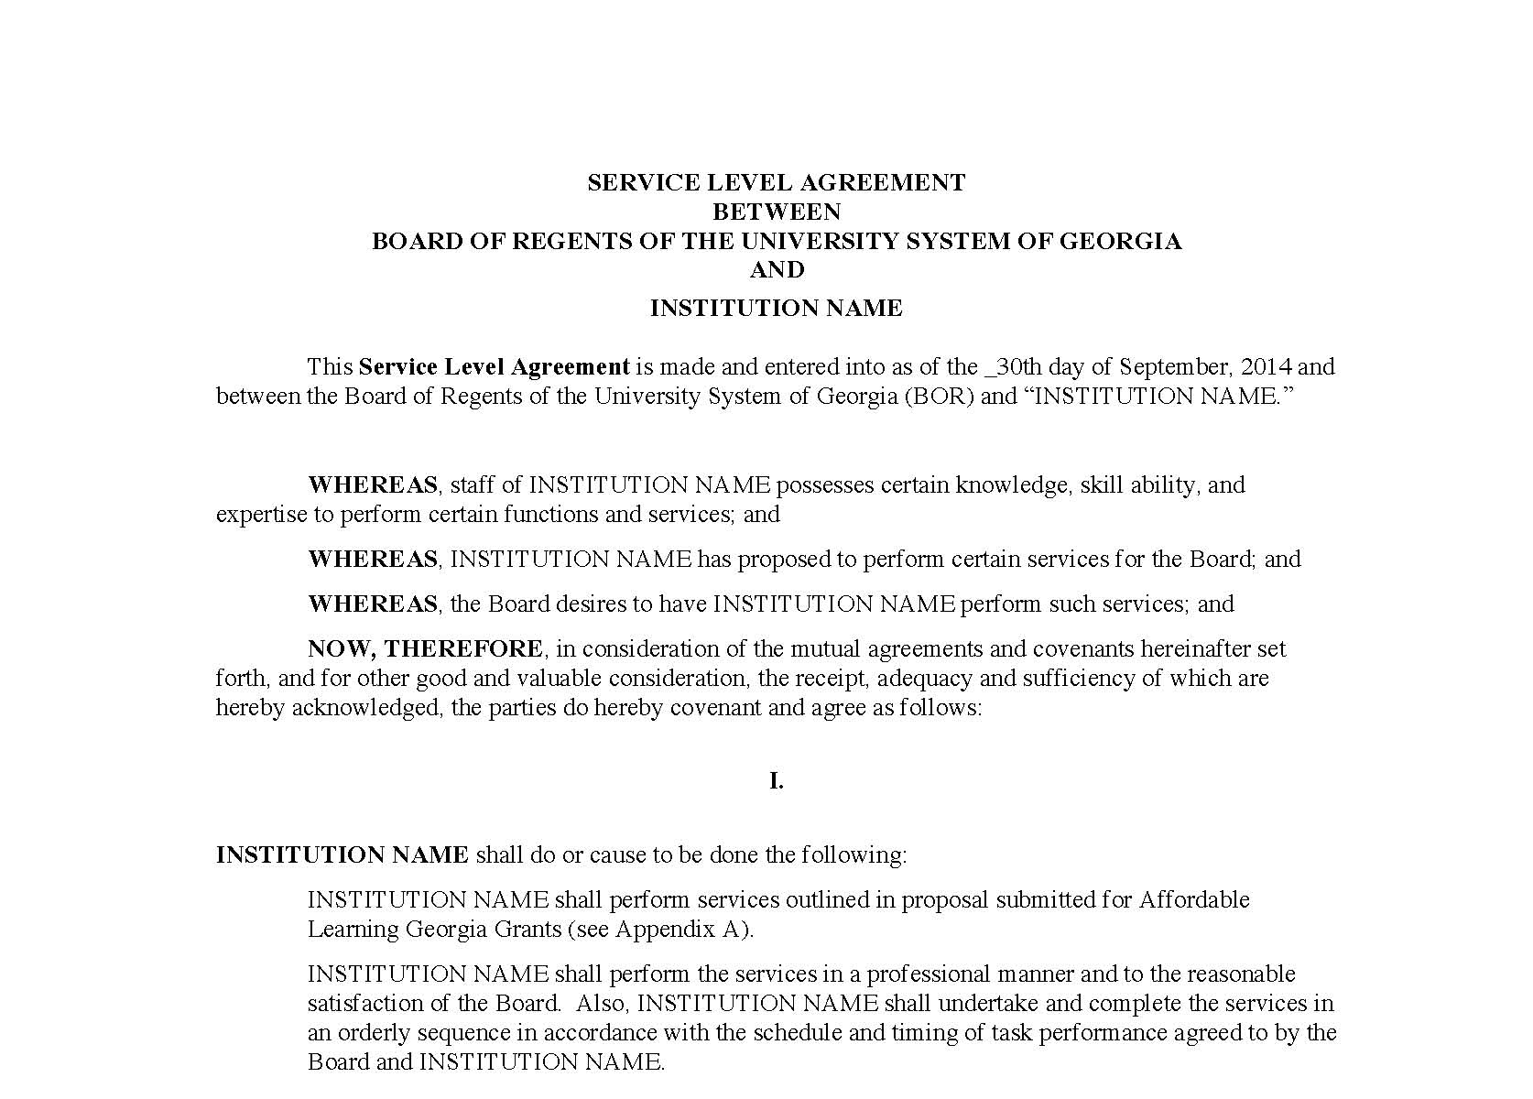
Service Level Agreement (SLA)
“Boilerplate” intergovernmental legal document ensuring that:
We fund the work in the Statement of Work, which is your proposal, and
Your institution ensures the work is completed by the deadline
Foundational document for all Textbook Transformation Grant funding
Includes deadlines (ensure that your Final Semester is correct!)

Slide 12
Steps: From SLA to Funding
SLAs drafted by Jeff
SLAs distributed to Project Leads with detailed instructions
Project Leads read the SLA and forward to appropriate business or grants office
Signatures obtained by business office
SLA and the invoice for first payment (1/2 the award) sent to Jeff in one email
This is extremely new! The USG Business Office now wants one invoice per payment for audit purposes.
Jeff enters signed documents into online system for Board of Regents approvals and signatures
Funds distributed from USG business office to institution: 50% now, 50% upon receiving Final Report
Jeff is point of contact for SLA status

Slide 13
Reports
Just one short Final Report!
Final Report will include:
Narrative Description of the revision/creation process
Links to the new materials
These can be in a Google Drive folder if you just want to have them in our repository
Consider OER Commons, especially for OpenStax, also
Next Steps and Future Plans
Location: On the Information for Round Fourteen Grantees page: http://www.affordablelearninggeorgia.org/about/r14_info/

Slide 14
Required Reporting
Timeline:
If it is your final semester, submit the Mini-Grant Final Report.
Report links and deadlines will be on the Information for Round Fourteen Grantees page:
affordablelearninggeorgia.org/about/r14_info
Please bookmark this page!
Also accessible through the Textbook Transformation Grants main page

Slide 15
Submitting New OER
New OER can usually be added to your Final Report during the submission process, but every so often, a file will be too big. If the sum of your file sizes is over 30MB, it’s probably too big.
If you have a big file, email Jeff (jeff.gallant@usg.edu) with a cloud storage link. For example, this could be in:
Google Drive
Dropbox
Microsoft Sharepoint
Jeff will add these to the appropriate place in the repository once they’re submitted and Final Reports are processed.

Slide 16
Resources and the R14 Info Webpage

Slide 17
Tour of R14 Info Webpage
Includes deadlines, Kickoff documents, and reports!
http://www.affordablelearninggeorgia.org/about/r14_info/

Slide 18
Keep in mind…
From the Kickoff Materials:
Open Education and Open Pedagogy
Copyright and Open Licensing (in the Procedures document)
Accessibility!
Slides from CIDI (previously called AMAC)
Additional details in an extra set of CIDI slides
Checklist from CIDI
List of resources from CIDI

Slide 19
GALILEO Open Learning Materials
A repository for all ALG grant projects!
https://oer.galileo.usg.edu/

Slide 20
Need the Basics on OER?
The ALG Help Section has two modular tutorials:
Finding OER: https://www.affordablelearninggeorgia.org/help/finding-1
Creating / Adapting OER: https://www.affordablelearninggeorgia.org/help/creating-1

Slide 21
Resources for those new to OER:
David Wiley’s blog, OpenContent: https://opencontent.org/blog/
New ideas on open education from one of the founders of Open Ed
Creative Commons: https://creativecommons.org/
Creators of the open licenses used throughout Open Education
Open Education Group: https://openedgroup.org/
Research group looking at perceptions, use, and efficacy of OER in the classroom
OER Research Fellows: Annual cohort researching OER
SPARC: https://sparc.org/
Nonprofit advocate for open access, open data, and open education

Slide 22
OER is Big on Twitter! Join the Conversation!
Start with:
@openstax,
@txtbks (Nicole Allen, SPARC)
@opencontent (David Wiley)
@thatpsychprof (Rajiv Jhangiani)
@openaccesselder (Abbey Elder)
@jeffwgallant, @ALearningGA (me, ALG)
Share your new OER there when they’re in the repository!!

Slide 23
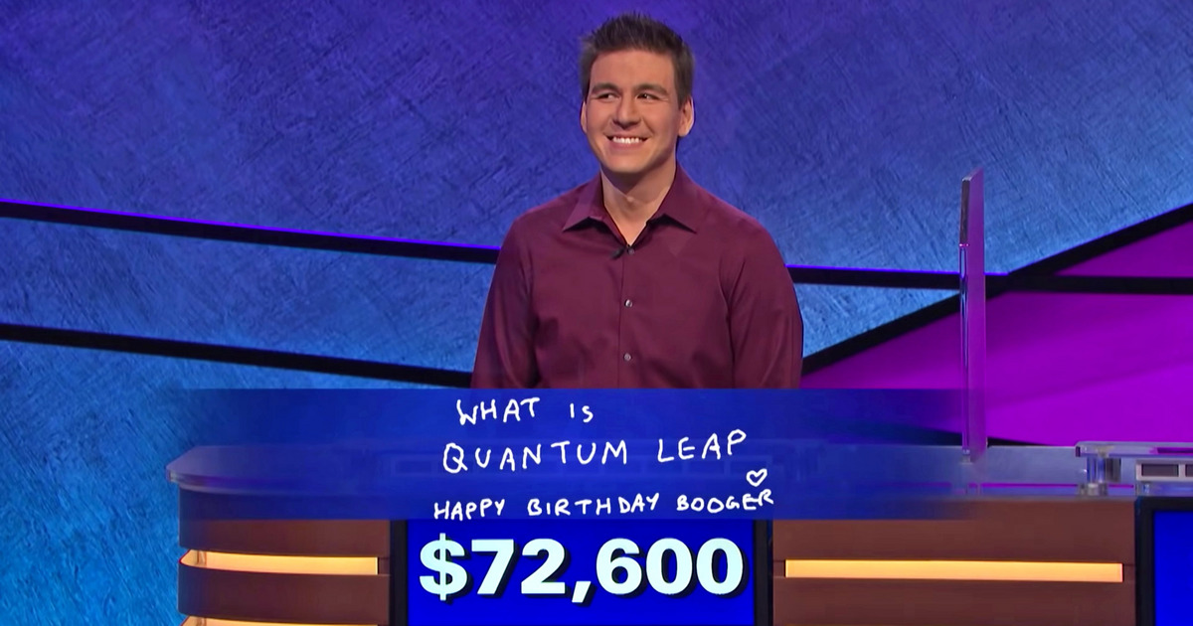
Questions?

