Slide 1
Creating Accessible Documents
Affordable Learning Georgia Training
Presenter: Valerie Morrison, Ph.D.
valerie.morrison@amac.gatech.edu

Slide 2
AMAC Accessibility
E-Text, Braille, Captioning and Audio Description, ICT Accessibility, AT Assessments

Slide 3
Who Needs Accessible Files?
Students need accessible files for all sorts of reasons:
Students with learning disabilities
Students who are blind/low-vision
Students with mobility issues
Students who are auditory learners
Students who are part of the growing aging population

Slide 4
What Needs to Be Made Accessible?
Ideally, everything your faculty creates should be accessible on the very first day of class:
Textbooks and Course Materials
Course Syllabi and Exams
Handouts
Courses Websites
Readings and Course Packets

Slide 5
3 Tips for Greater Accessibility
Keep these 3 ideas in mind for greater accessibility across all programs:
1. Is my content easy to navigate?
Have I created headings and bookmarks for easy navigation?
2. Are my visuals clearly and fully described?
Have I written alt text descriptions and captions for my images?
3. Are my design choices accessible?
Have I chosen fonts, colors, and backgrounds that are easy to discern?

Slide 6
Adding Headings for Navigation
Add Headings to Microsoft Word Docs for easy navigation and to mark important chapters or subsections.
Highlight a word or line in your document and select a Heading Level in the Styles group on the Home Ribbon.
To view all Headings within your document, click on the View Tab and check the Navigation Pane box.

Slide 7
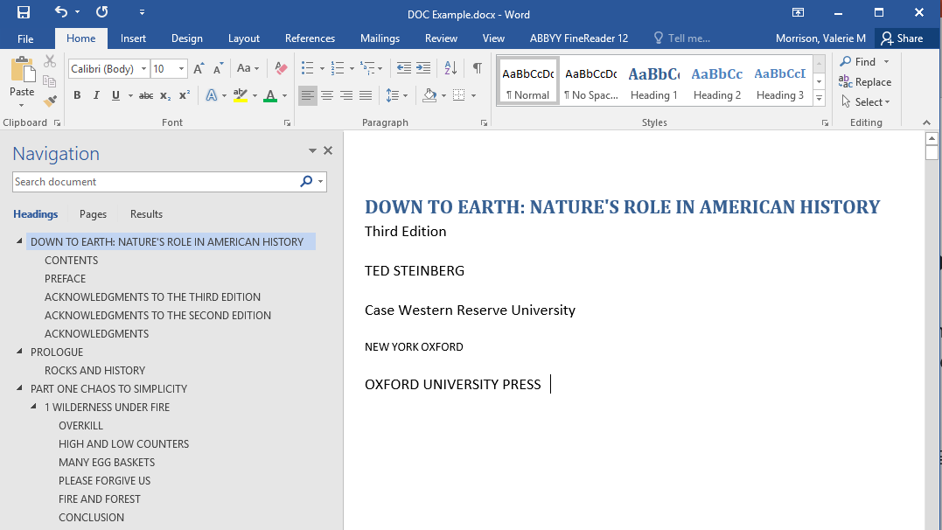
The Navigation Pane in Microsoft Word

Slide 8
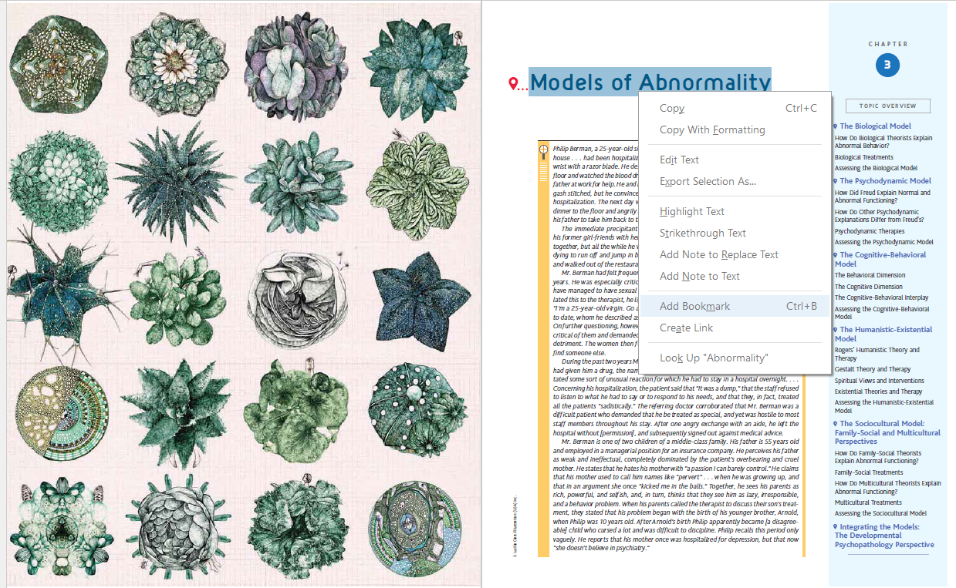
Adding Bookmarks for Navigation
Add Bookmarks to PDF files to allow for easy navigation. Highlight text and right click, or press CTRL + B.

Slide 9
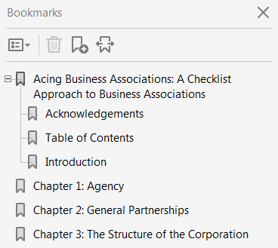
The Bookmarks Pane in Adobe
To adjust the hierarchy of your bookmarks, drag them up and under the “parent bookmark” so they appear indented.
You can edit the text of a bookmark, to include the word “Chapter” for instance.

Slide 10
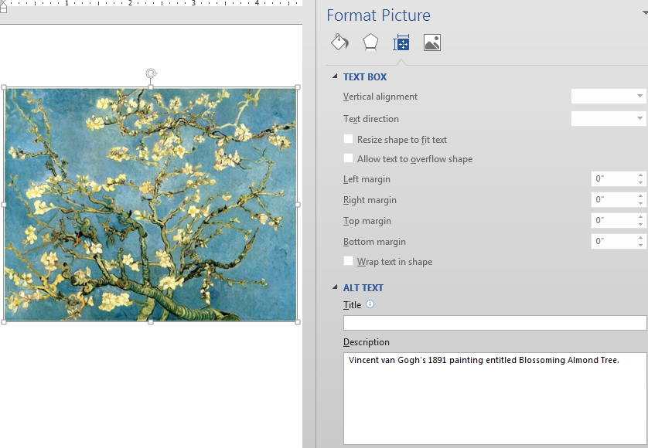
Writing Alt Text Description for Images
All images in a document should be fully described using proper capitalization, grammar, spacing, and punctuation.
To add alternate text to an image:
Right-click the image.
Choose Format Picture.
Select the Layout Properties icon.
Click on the Alt Text link.
Type in the description field.

Slide 11
General Rules for Writing Alt Text
First describe the type of image you’re attempting to describe.
Next, summarize the information contained in the image in a general informative sentence.
Avoid adding subjective information or opinion in your alt text, keeping your description neutral and informative.
Skip purely decorative images; these will be read simply as “Graphic.” Icons may have meaning, but flourishes are fluff.

Slide 12
Effective Alt Text Practices
Review captions before writing your alt text. If the caption does not summarize the information, then write alt text that does to fill in the blanks.
Alt text should have proper capitalization, subject/verb agreement, usage of articles such as a/an, spacing, grammar, spelling, and punctuation.
Do not include hard line breaks.
Avoid using abbreviations if possible.
Symbols: instead of "&" write out the word "and"; do not use mathematical symbols (ex: write out "divided by," "minus," and "equals").

Slide 13
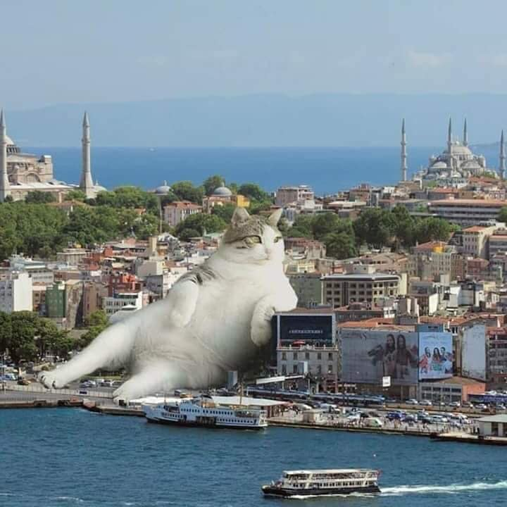
How Would You Describe This Simple Image?

Slide 14
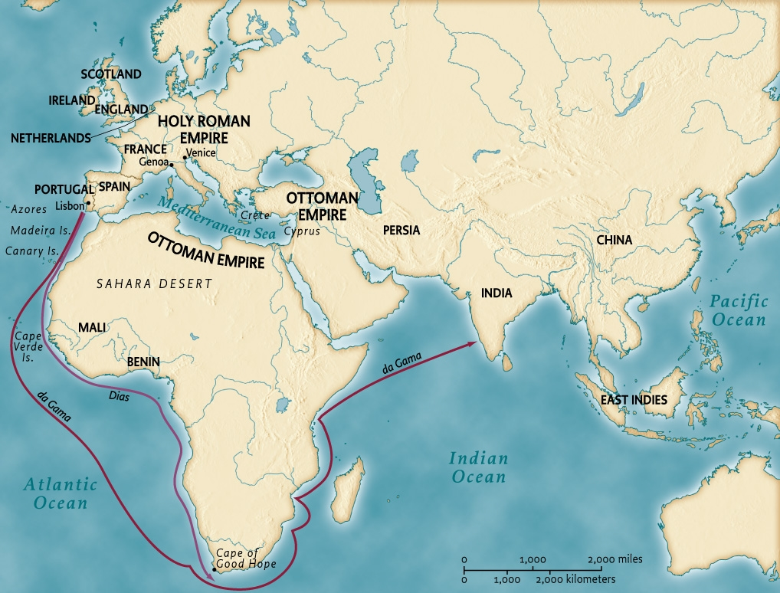
This Moderate Image?

Slide 15
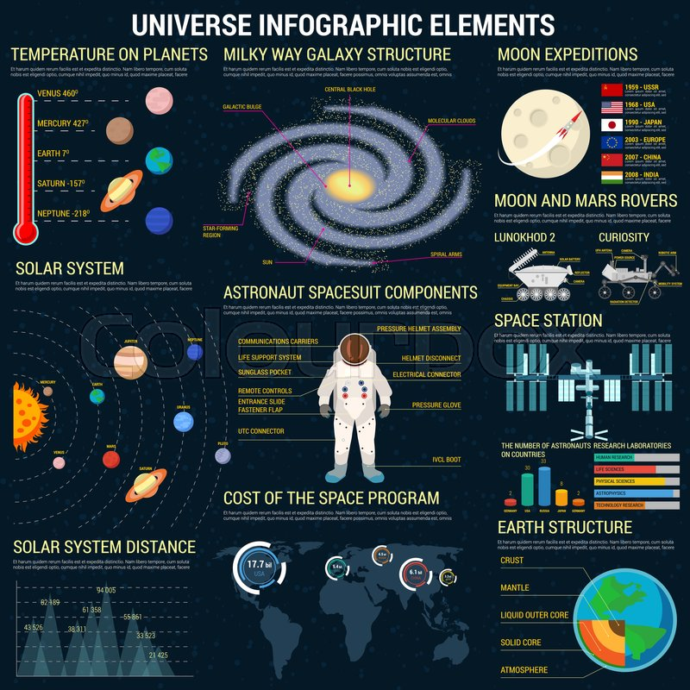
This Complex Image?
Best practice for adding alternate text to images is 125 characters.
The default setting for JAWS screen reading software pauses after 250 characters.
However, depending on context, the purpose of the image, the educational value, and the needs of the audience, alt text can get quite long.

Slide 16
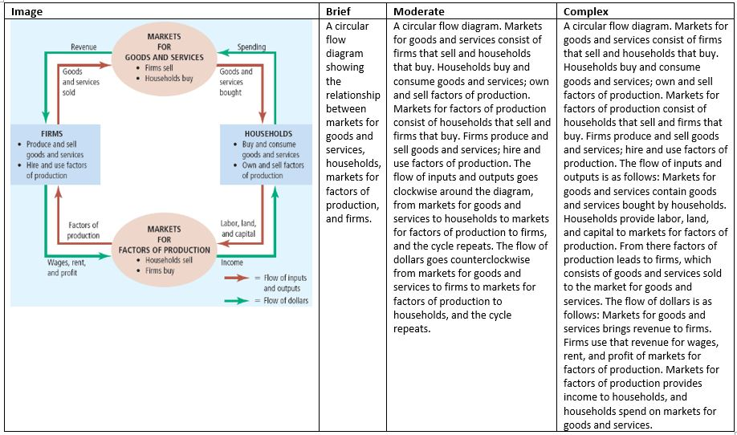
Consider your Purpose and Audience
What level of detail do you need for your image description: brief, moderate, or complex?

Slide 17
Making Accessible Design Choices
Below are some design choices to be made with accessibility in mind:
Font size (12 pt. minimum).
Sans serif fonts are best (Calibri, Arial, Verdana).
Avoid large amounts of italicized, bold, underlined, or capitalized text.
Color contrast should reduce eye strain (yellow text on black background is most accessible).
Do not rely on color coding to convey meaning.
Avoid relying on graphics, including lines or shapes in your design.
If you must use a graphic, try to convey the meaning in text as well.
Explain all acronyms, symbols, and abbreviations for your audience.
Provide meaningful context for hyperlinks whenever possible.

Slide 18
Lunch Break 12:00 to 1:00
After lunch: Creating Accessible Microsoft Word, PDF, Excel, and PowerPoint Files

Slide 19
Microsoft Word Doc Accessibility
Choosing accessible fonts and design features.
Creating multiple levels of headings for navigation.
Generating an automated table of contents.
Writing alternate text descriptions and/or captions for images.
Creating accessible numbered and bulleted lists.
Establishing a logical reading order.
Formatting accessible tables and not using tables for layout purposes.
Creating white space with page layout tools (not tab, enter, space bar).
Using column breaks, section breaks, and page breaks.
Using the built in checker to create an accessibility report.

Slide 20
PDF Accessibility
Save as PDF from MS Word to retain accessibility features.
Text is accessible and highlights in proper reading order.
Bookmarks provide organization and easy navigation.
Pagination is clear and navigable.
Tags are present, or the file is autotagged.
File size is manageable, ideally under 25 MB.
File names are clear and contain no symbols.
Images have alt text descriptions if necessary, using T.U.R.O. tool.
Language and metadata are included in document properties.
Color contrast is high for ease of reading.

Slide 21
PowerPoint Accessibility
Use Layout Templates so that all text is visible in the outline view.
All slides should have unique titles for easy navigation and clarity.
Choose fonts and color contrast for greatest visibility.
All graphics/images should have brief alternative text descriptions.
Create white space with page layout tools (not tab, enter, space bar).
Tables should have a header row, alt text description, and caption.
Lists should be created with the bullet and list toolbar buttons.
Reading order can be adjusted in the Selection Pane.
Add metadata (title, author) on the File Tab.
Use the built in checker to create an accessibility report.

Slide 22
Excel Accessibility
Consider design and formatting in terms of clarity.
Each sheet tab should have its own unique name.
If content is in table format, include clear column and row headings.
Do not merge cells or leave table cells blank if possible.
Bulleted and numbered lists are created using the built-in options.
Do not rely on color coding to convey meaning.
Graphics, smart art, charts, shapes, and tables should have alternate text descriptions.
Go to File, then click on Check Issues, and then Check Accessibility to run a report listing issues you need to fix.

Slide 23
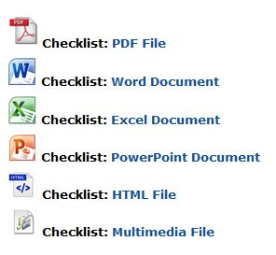
Official Section 508 Checklists
You can find helpful 508 Checklists on the United States Department of Health and Human Services Website:
Source: Department of Health and Human Services website (https://www.hhs.gov/web/section-508/making-files-accessible/index.html).

Slide 24
Have Further Questions?
Contact our Customer Support Team by phone (404) 894-7756 or by email amactech@amac.gatech.edu

Slide 25
www.amacusg.org

