Slide 1

Nicole Finkbeiner
Associate Director
Institutional Relations
Peer-reviewed, quality OER

Slide 2
$1,200
Average per year cost for textbooks and supplies
Fixing the Broken Textbook Market report by U.S. PIRG Education Fund
January 2014

Slide 3
48%
of all students surveyed said that the cost of textbooks impacted how many/which classes they took each semester
Fixing the Broken Textbook Market report by U.S. PIRG Education Fund
January 2014

Slide 4
65%
of students said that they had decided against buying a textbook because it was too expensive
Fixing the Broken Textbook Market report by U.S. PIRG Education Fund
January 2014

Slide 5
95%
of students who had foregone purchasing a textbook were concerned that doing so would hurt their grade in a course
Fixing the Broken Textbook Market report by U.S. PIRG Education Fund
January 2014

Slide 6






Foundation Support

Slide 7
Meeting the OER Challenge
Ease of Use
Make it EASY to find and use the materials
Free is not Enough
Establish development models to ensure quality
Scope and Sequence
Develop resources to support existing curricula
Essential Learning Resources
Partner with groups that can enhance content

Slide 8






Our books thus far

Slide 9
Schools using our resources
840+ schools worldwide using OpenStax books
Examples:
  Austin Community College
  University of Oklahoma
  Houston Community College
  University of Georgia
  Tulsa Community College
  University College Dublin
  Ohio State University
  Baylor College of Medicine
  Rice University
  Central New Mexico Community College
  Universidad de Alicante, Spain

Slide 10
Press

Slide 11
OER Enhances Academic Freedom
At the course level:
OER provides faculty with more choices for their courses
OER allows for permission free editing and adaptation
OER prevents faculty from being locked into a particular platform or system
In the market place:
OER should not be legislated or mandated
OER needs to stand on it’s own vis a vis publisher material

Slide 12

OER Enhances Academic Freedom
Distribute
Remix
Tweak
Build upon
Commercial use allowed
Only attribution required

Slide 13
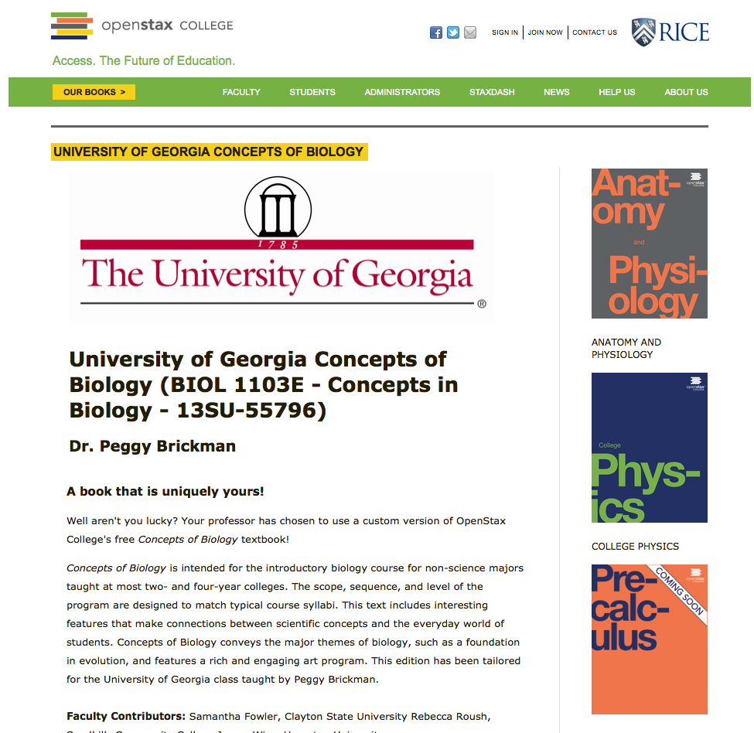
Customized Versions, Personalized Pages

Slide 14
No Passwords, No Registrations,
Available in Many Formats

Slide 15

Knowledge Ecosystem.
Learning requires more than a book
Only_point_five (CC-BY-NC bit.ly/HpxBgx)

Slide 16
Additional Resources
Online homework (from partners)
Online labs (from partners)
Online practice (from partners)
PowerPoint slides
Pronunciation guides
Solution Manuals
Test banks

Slide 17
Adopt/Recommend
Adopt an OpenStax College book as the main textbook
Recommend an OpenStax College book as an option for studying/affordability

Slide 18
Instituitional Initiatives
How to implement OER as an institution
Textbook Heroes
Faculty pilots
Faculty support
    Instructional Design/IT
    Library
    Incentives (not mandates)
        Institutional grants
        Student organization grants
Expressed support from administration
OER training days/webinars

Slide 19
FAQs
What’s the catch or obligation?
Do you plan on switching to a fee model?
“I don’t like X or you don’t have Y”
Do you have SSO?
May I adapt and distribute without permission?
Do you have comp copies?
With no sales reps how do I get service?
What about revisions?
Who do I call if I find an error?
Can my bookstore order physical copies?

Slide 20
$30 MILLION SAVED!

Slide 21
Nicole Finkbeiner
Associate Director, Institutional Relations
nicolef@rice.edu
713-348-2972

