Slide 1
Textbook Transformation Grants
RFP Review
Jeff Gallant, Program Director, Affordable Learning Georgia

Slide 2
What are Textbook Transformation Grants?
Opportunities for teams of faculty and professional staff to transform courses with commercial textbooks to courses using OER and other affordable materials
Opportunities for individuals or teams to improve previously-created OER
How time is funded varies by institution.

Slide 3
Request for Proposals
http://www.affordablelearninggeorgia.org/about/rfp_r16/
January 13, 2020: Deadline for applications
January 14-30: Peer and Administrative Reviews
January 31, 2020: Notification Date
February 24, 2020: Kickoff Meeting, Middle Georgia State University Hatcher Conference Center
For standard and large-scale grants, at least two team members will participate in the required in-person Kickoff Meeting to kick-off project implementation.
(Mini-grants: Only Online Kickoff to discuss procedures required, but welcome to attend)

Slide 4
Textbook Transformation Grants: Standard / Large-Scale

Slide 5
Funding Levels: Standard-Scale
Standard-Scale Transformation: Textbook transformation projects within one or more courses or sections with under 500 students enrolled on average per academic year total.
$10,800 maximum award
$5,000 maximum per team member
$800 for travel and overall project expenses
The $800 is a required part of the budget, ensuring that at least two team members can attend the Kickoff Meeting at Middle Georgia State University in Macon, GA.

Slide 6
Funding Levels: Large-Scale
Large-Scale Transformation:
Textbook transformation projects within one or more courses or sections with 500 or more students enrolled on average per academic year total,
or department-wide, all-section adoptions at a similarly large scale.
$30,000 maximum award
$5,000 maximum per team member
$800 for travel and overall project expenses
The $800 is a required part of the budget, ensuring that at least two team members can attend the Kickoff Meeting at Middle Georgia State University in Macon, GA.

Slide 7
What if I have other project costs?
You can incorporate project expenses (such as authoring tools/platforms, equipment) into the grant as well.
If you do, please make this very clear to reviewers in the budget section, along with why those expenses are necessary within your plan.

Slide 8
Priority Categories
The following Priority Categories receive some priority (extra points) for fitting a strategic goal of ALG.
These are not requirements for applying for a grant – the most important factors in being awarded are impact and the quality of the application/plan.

Slide 9
Specific Core Curriculum Courses
Grants in this category address the following courses within the USG Core Curriculum that have not had a Textbook Transformation Grant or eCore implementation.

Slide 10
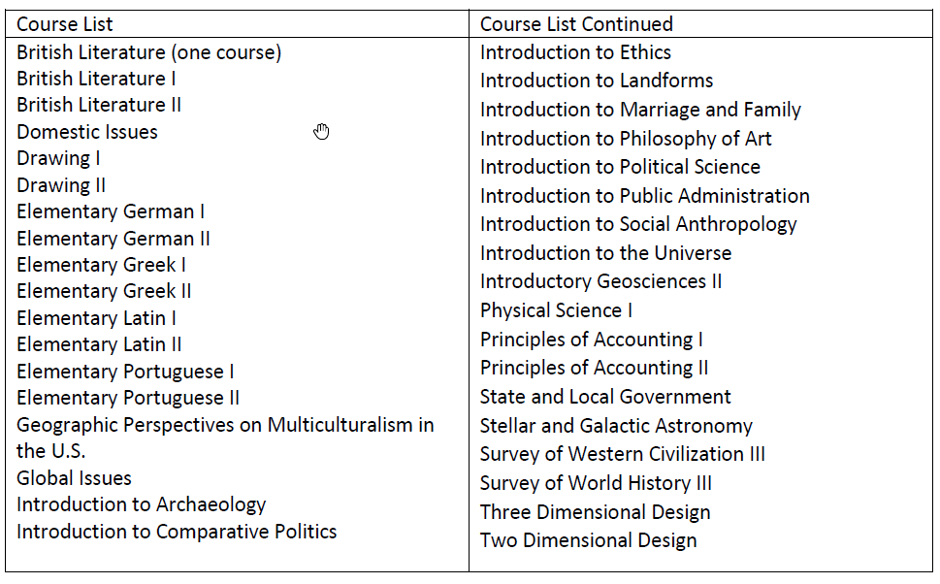
Specific Core Curriculum List (2019-2020)

Slide 11
Gateways to Completion (G2C) Courses
Projects in the Gateways to Completion (G2C) Courses category are intended for involving OER and no-cost materials in the transformation of a Gateways to Completion cohort course.
These courses are specific to particular institutions participating in the G2C program.

Slide 12
Scaling Up OER
Projects in the Scaling Up OER category are intended for moving a standard-scale Textbook Transformation Grant team’s previously-completed project to a department-wide, all-sections scale.
Funding for this category is identical to large-scale transformation grants.

Slide 13
Upper-Level Campus Collaborations
These projects must result in the implementation and possibly creation of OER in upper-level (3000-level and up) undergraduate courses and graduate courses.
While not required, it is heavily encouraged that team members collaborate within multiple campuses to create a larger impact on students. These multi-institution projects can request the $30,000 large-scale maximum without either a department-wide scale or 500+ student count.

Slide 14
Upper-Level Campus Collaborations Breakdown
Upper-level courses, not multi-institution: Priority points, but not large-scale funding (unless it already meets large-scale requirements)
Upper-level courses, multi-institution: Priority points and can take large-scale funding
Why? To account for the expenses and extra time associated with long-distance collaboration.

Slide 15
Mini-Grants for Ancillary Materials Creation and Revisions

Slide 16
Funding Levels: Mini-Grant
Mini-Grants: Special projects targeted toward review, sustainability, and revisions. Mini-grants can support both individual and team projects. Mini-Grants have different deliverables and reporting guidelines than standard or large-scale Textbook Transformation Grants.
$4,800 maximum award
$2,000 maximum per team member
$800 maximum for overall project expenses
Unlike standard-scale and large-scale transformations, this maximum of $800 is not a required element of the budget, but rather meant for the purchase of specific tools and software which would help with improving resources.

Slide 17
Mini-Grants Explained
Mini-Grant: OER Ancillary Materials Creation and Revisions Defined
For the purposes of this grant, we define revision as the major adaptation and/or improvement of a resource through updates for accuracy, accessibility, clarity, design, and formatting.
We define ancillary materials as any materials created to substantially support the instruction of a course using an existing open educational resource(s).

Slide 18
Mini-Grants Deliverables
Mini-Grant: OER Revisions and Ancillary Materials Creation
The final deliverable for this category is the revised or newly-created materials as proposed in the application, which will be hosted through GALILEO Open Learning Materials.
A Final Report with a narrative description of the project is also required.
All revised or newly-created materials will be made available to the public under a Creative Commons Attribution License (CC-BY), with exceptions for some more restrictive licenses including SA (Share-Alike) or NC (Non-Commercial).

Slide 19
Funding

Slide 20
Funding
Funding goes to the institution to cover the team member’s time (depending on the institution’s policies), project expenses including related department needs, and travel expenses
Funding process through Service Level Agreement (SLA), 50% on execution, 50% Final Report
$800 specifically designated for at least two team members to attend the required in-person kickoff meeting
(Standard/Large-Scale Required Only)

Slide 21
Funding: Additional Guidelines
Institutional sponsors will be responsible for fund disbursement, including expense and travel reimbursement.
Budgets will be supported by State funds and therefore institutions spending project money must ensure compliance with State, BOR and institutional policies and procedures.

Slide 22
How to Apply: Mini-Grants for Revision and Ancillary Materials Creation

Slide 23
Mini-Grant Applications
Tour of Application Form:
https://goo.gl/forms/FtJbmpIkheKx8S8C2

Slide 24
How to Apply: Standard-Scale and Large-Scale Textbook Transformation Grants

Slide 25
Proposals: Required Elements
For mini-grants, just the Google Form linked in the RFP.
For Standard-Scale and Large-Scale:
Completed Proposal Application in InfoReady Review
The .docx Proposal Narrative Document has instructions in italics
Letter of support
The letter must be provided from the sponsoring area (unit, office, department, school, library, campus office of the Vice President for Academic Affairs etc.) that will be responsible for receipt and distribution of funding.
For multi-institutional teams, letters of support must come from each institution’s sponsoring area.

Slide 26
How to Apply
First, bookmark this page:
https://www.affordablelearninggeorgia.org/about/rfp_r16/
Complete the offline .docx proposal linked on the RFP website. Keep this saved in case you need to refer to it later.
Walk through the submission process in InfoReady Review linked on the RFP website with the completed .docx proposal.

Slide 27
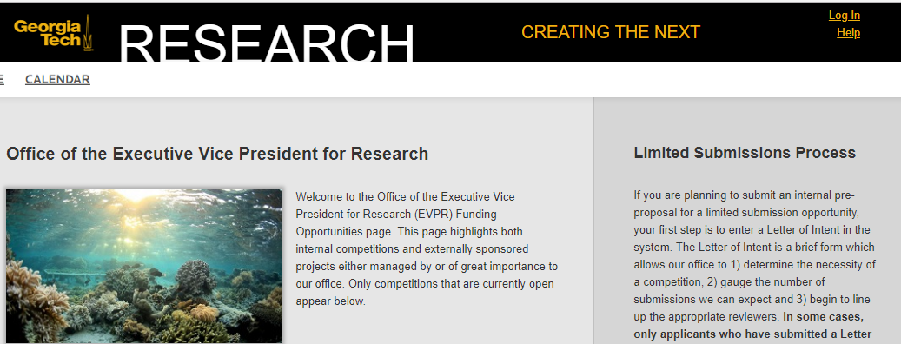
How to Apply: Creating an Account

Slide 28
How to Apply: Registering, Non-GA Tech

Slide 29
How to Apply: Registering, Non-GA Tech (2)

Slide 30
How to Apply: Registration Confirmation

Slide 31
How to Apply: GA Tech Teams

Slide 32
How to Apply: Look for an Email from @gatech.edu

Slide 33
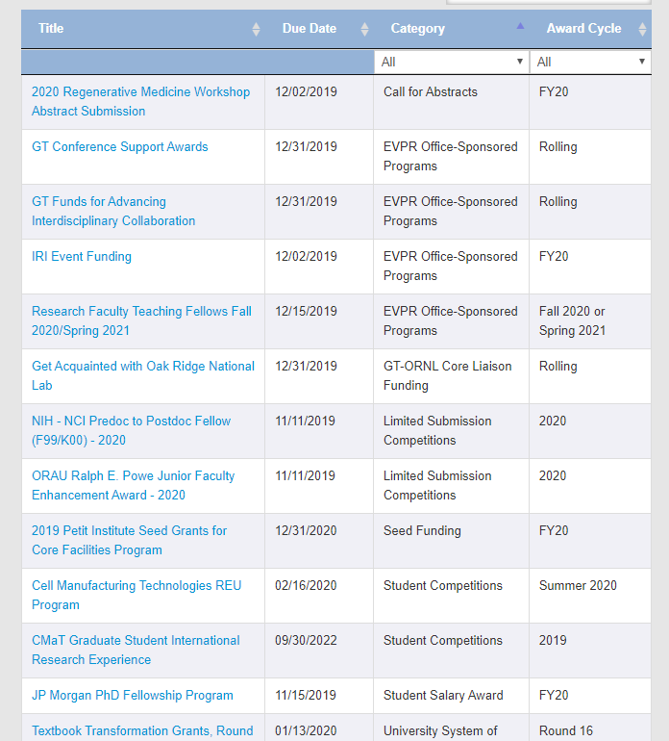
Find the Grants: Scroll Down on the Front Page or use the Direct RFP Link

Slide 34
Tour of Application Form
Application Form Direct Link:
https://gatech.infoready4.com/#competitionDetail/1798481

Slide 35
Warning: Always Use a Bulleted List, Not a Table
InfoReady Review is temperamental with tables – sometimes they work, sometimes they break your application, sometimes it makes the application unreadable to reviewers.
When writing elements in Word, please use bulleted lists instead of tables whenever possible. Then, copying and pasting will be easy.

Slide 36
Application Received Email

Slide 37
Application Accepted for Reviews Email

Slide 38
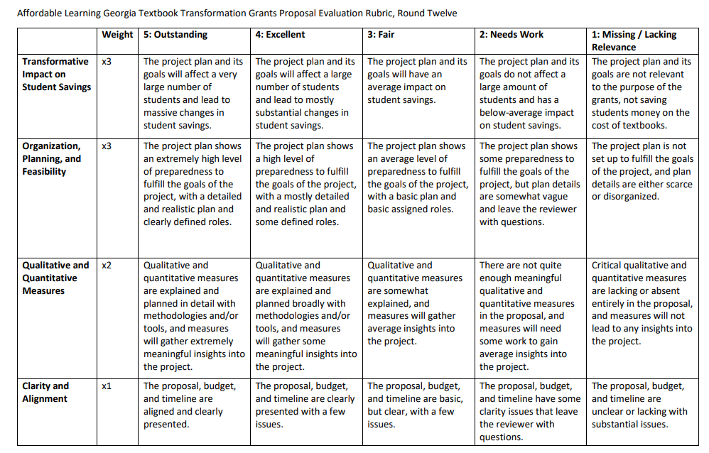
Peer Review: Three Reviewers, Weighted Rubric
(since R12)
https://affordablelearninggeorgia.org/documents/Rubric_Weighted.docx

Slide 39
Thank you!
For questions, contact Jeff Gallant:
Jeff.Gallant@usg.edu

