Slide 1
Affordable Materials Grants: RFP Review
Jeff Gallant, Program Director, Affordable Learning Georgia
Jeff.Gallant@usg.edu

Slide 2
Introduce Yourself!
In chat, please share:
Your institution / department
First time with ALG or returning?
Why are affordable / open resources important to you?

Slide 3
Affordable Materials Grants: Transformation Grants

Slide 4
What are Transformation Grants?
Transformation Grants are opportunities for individuals or teams of faculty and professional staff to transform courses with commercial textbooks to courses using OER and other affordable materials.
Continuous Improvement Grants are opportunities for individuals or teams to improve previously-created OER.

Slide 5
Funding Structure
Transformation projects have specific funding guidelines:
$5,000 maximum award per individual team member for salary, course release, travel, etc.
Additional project expenses allowed, but must be justified in proposal budget
$30,000 maximum total award per grant

Slide 6
What if I have other project costs?
You can incorporate project expenses (such as authoring tools/platforms, equipment, travel) into the grants.
If you do, please make this very clear to reviewers in the budget section and explain why those expenses are necessary for project success within your plan.

Slide 7
Continuous Improvement Grants

Slide 8
Continuous Improvement Grants Explained
Continuous Improvement Defined
Continuous Improvement Grants are not awarded simply for doing routine course revision work. CI Grants can include:
A substantial revision of existing OER through updates for accuracy, accessibility, clarity, design, and compatibility (formatting, code, etc.)
The creation of new OER, from texts to ancillary materials, to improve the course
Ancillary materials are any materials created to substantially support the instruction of a course using an existing open educational resource(s).

Slide 9
Funding Structure
Continuous Improvement Grants also have specific guidelines for funding:
$2,000 maximum per team member for salary, course release, travel, etc.
Additional project expenses allowed, but must be justified in proposal budget
$10,000 maximum total award per grant
Notes:
Removed last bullet

Slide 10
Priority Categories

Slide 11
Priority Categories
The following priority categories receive some priority (in extra points) for fitting a strategic goal of ALG.
These are not requirements for applying for a grant—the most important factors in being awarded are impact and the quality of the application/plan.

Slide 12
Collaborative Projects with Professional Support
Grants in this category involve at least one collaborator outside the team of course instructors. These team members might include:
instructional designers
librarians
OER publishers
instructional technologists
web designers
programmers
graphic designers

Slide 13
Student Participation in Materials Creation, Adaptation, and Evaluation
Involving students in content creation, remixing, editing, and evaluation of resources is one way to enhance student learning while increasing student agency in the classroom.
Grants in this category will include students as active participants.

Slide 14
Department Scaling Projects
Grants in this category will implement open, no-cost, or low-cost materials on a department-wide, all-sections scale.
Note: there must be a commitment from the department to at least pilot the project in all sections for this category; solely the potential for departmental scaling does not qualify for this priority.

Slide 15
Upper-Level Campus Collaborations
In order to address the gap in OER and no-/low-cost resources in upper-level undergraduate and graduate courses with smaller enrollment numbers, we are encouraging these teams to collaborate across institutions.
Grants in this category will involve collaboration between institutions for upper-level courses.

Slide 16
Funding

Slide 17
Funding
Funding goes to the institution to cover the team member’s time, project expenses including related department needs, and travel expenses per your Proposal / Statement of Work and their policies.
Funding process through Service Level Agreement (SLA), 50% on execution, 50% Final Report

Slide 18
Funding: Additional Guidelines
Institutions (typically grants, research, and/or business offices) will be responsible for fund disbursement, including salary, expense, and travel reimbursement.
Budgets will be supported by state funds and therefore institutions spending project money must ensure compliance with state, BOR and institutional policies and procedures.
This does not usually include the more extensive guidelines for federal or external grants, but your institution may vary on this.

Slide 19
Funding: Direct Only
These grants cannot include indirect expenses.
Direct expenses (allowed) fund the project directly: salary, fringes that go with salary (healthcare, taxes, etc.), project supplies, software, etc.
Indirect expenses (not allowed) fund the institution to support an external project: F&A (facilities and administration) are the most common indirect expenses.

Slide 20
Timeline

Slide 21
Timeline: R22
Round 22: Projects Ending Summer-Fall 2023
Monday, October 31, midnight: Application Deadline
Tuesday, November 1 – Tuesday, November 15: Peer Reviews
Wednesday, November 16 – Monday, November 21: Administrative Reviews
Tuesday, November 22: Notifications
Friday, December 9: Online Kickoff, 1-4pm

Slide 22
Kickoff Requirements
Transformation Grants: at least one team member will participate in the required online synchronous kickoff meeting. All members are required to participate in the asynchronous training.
Continuous Improvement Grants: Participation in the synchronous online kickoff meeting is optional but recommended. Participation in the asynchronous training is required.

Slide 23
Before we move on…
We’re about to run through how to apply for a grant.
Before that happens, any questions about what we just went through?

Slide 24
How to Apply

Slide 25
How to Apply
Bookmark the R22 RFP page on the main Grants Page. Be sure to read through the RFP!
Complete the appropriate offline .docx proposal linked on the RFP website.
Officially apply using the online form linked on the RFP website with your completed .docx proposal.
Notes:
Accessible link

Slide 26
Word Documents Walkthrough

Slide 27
Online Application Walkthrough

Slide 28
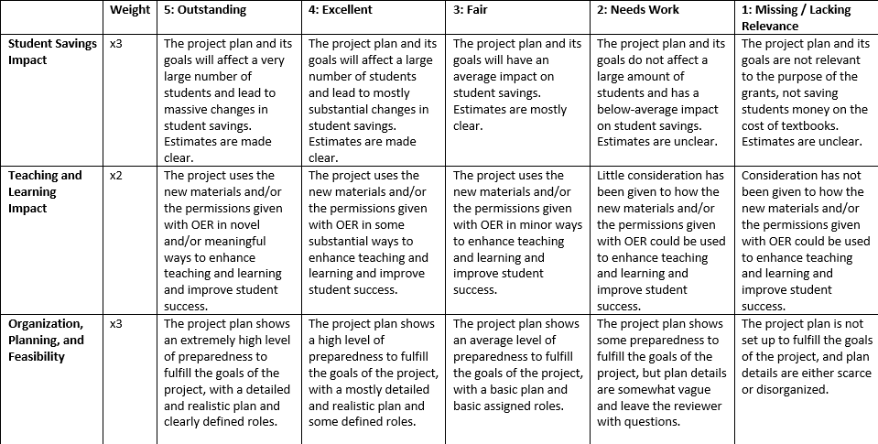
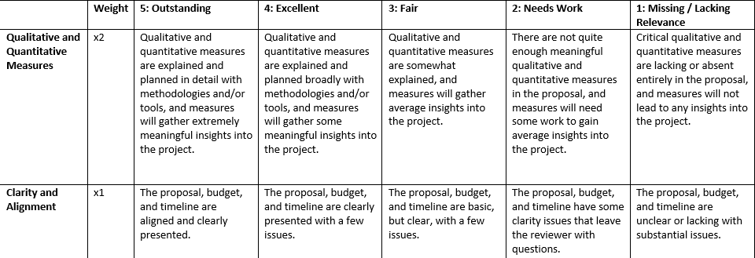
Peer Review: Three Reviewers, Weighted Rubric
Transformation Grants
You can find the rubrics linked on the RFP pages.
Notes:
Accessible link

Slide 29
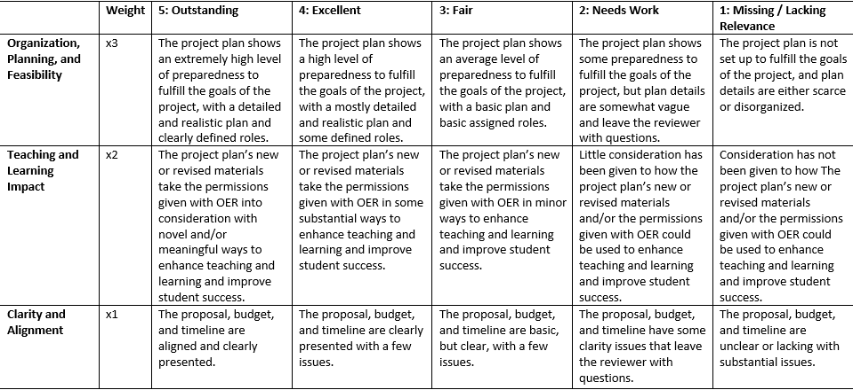
Peer Review: One Peer Reviewer, Weighted Rubric
Continuous Improvement Grants
You can find the rubrics linked on the RFP pages.
Notes:
Accessible link

Slide 30
Questions?

Slide 31
Thank you!
For questions, contact:
Jeff.Gallant@usg.edu

