Slide 1


OER Accessibility
Hosted by Affordable Learning Georgia (ALG)
This work is licensed under a Creative Commons Attribution 4.0 International License.

Slide 2
Purpose & Objectives
This webinar builds on national momentum around accessibility compliance and an urgent priority across higher education as institutions prepare for updated ADA Title II digital accessibility requirements and upcoming WCAG‑aligned standards on April 24, 2026. At the conclusion of this training, participants will be able to:
Apply core WCAG accessibility principles when creating or supporting OER and other course materials.
Identify common accessibility barriers in digital learning content and implement efficient, effective fixes.
Develop actionable strategies to support inclusive learning and institutional compliance efforts.

Slide 3


Agenda
OER & ALG Basics
Accessibility Standards Primer
Compliance Demos
Resources
Q & A

Slide 4


OER & ALG Basics
Nakita Afaha
Program Manager
Affordable Learning Georgia
University System of Georgia

Slide 5

What are OER?
Open Educational Resources (OER) are learning, teaching and research materials in any format and medium that reside in the public domain or are under copyright that have been released under an open license, that permit no-cost access, re-use, re-purpose, adaptation and redistribution by others.
https://www.unesco.org/en/open-educational-resources

Slide 6
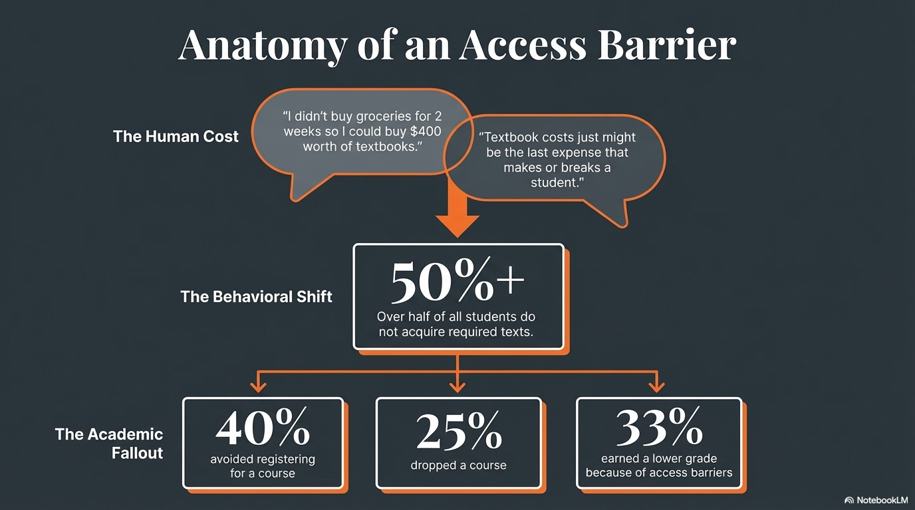
Anatomy of an Access Barrier

Slide 7
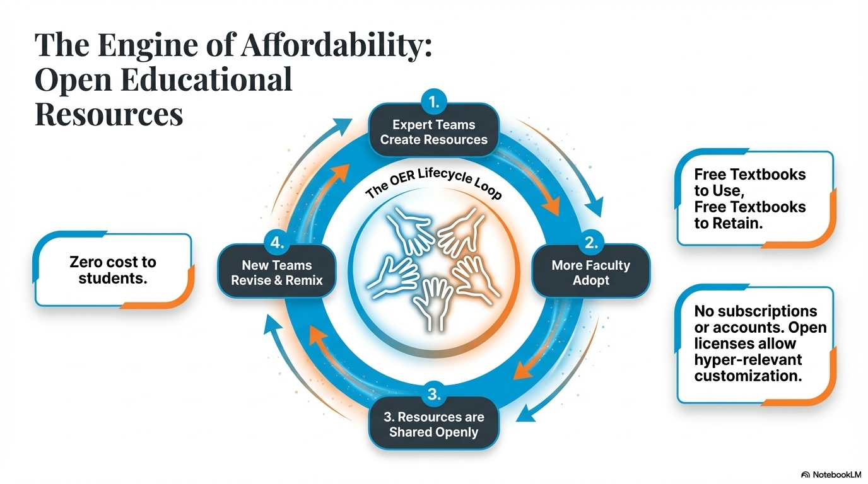
The Engine of Affordability

Slide 8
Enter ALG
In 2013, Affordable Learning Georgia began as a GALILEO pilot initiative to reduce the cost of course materials for students and enhance the discovery of library materials through GALILEO. The initiative continues to address affordability goals in the University System of Georgia’s strategic plan through our mission & vision.
Mission - Affordable Learning Georgia promotes student success and levels the playing field for all students through supporting the adoption, adaptation, and creation of affordable and open educational resources by USG faculty and professional staff.
Vision - Affordable, accessible, high-quality educational resources for every USG student in every course

Slide 9
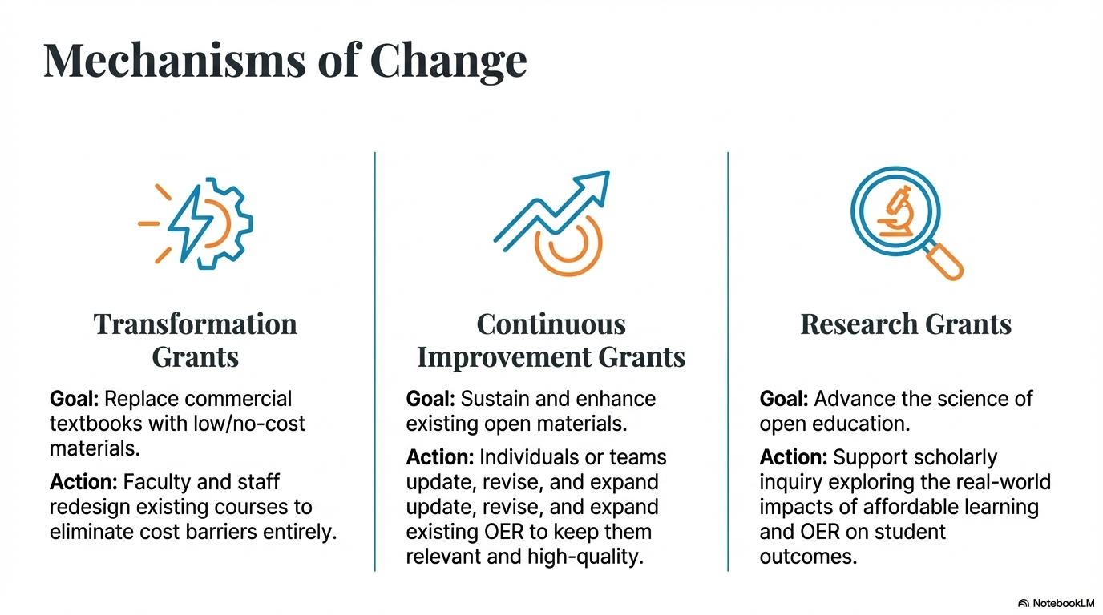
Mechanisms of change

Slide 10
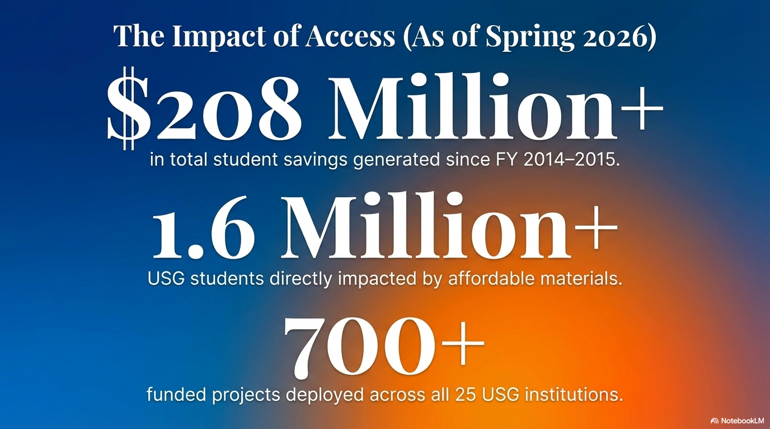
The impact of Access

Slide 11
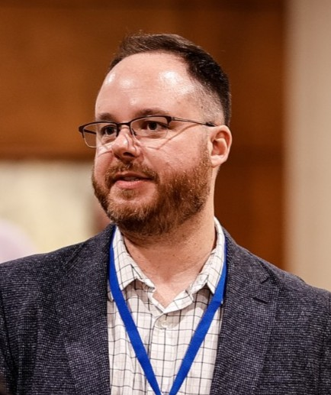
Accessibility Standards Primer
Jeff Gallant
Program Director
Affordable Learning Georgia
University System of Georgia

Slide 12

Accessibility and a New ADA Rule
From the Department of Justice: By April 26, 2026, all content on the Web made available to the public or used in services, programs, and activities must comply with the Web Content Accessibility Guidelines (WCAG) 2.1, Level AA.
Level AA means the middle level of accessibility.
Level A = technically accessible but not much.
Level AAA = everything should be this accessible, but it requires many experts and hours of work. (Things like ASL interpretation for all videos.)
Notes:
Jeff

Slide 13
ADA Exceptions? Not for OER.
Limited exceptions apply for hosting but not for use in a class:
- Archived web content: files that are not intended to be used, just stored for historical purposes. These need to be in a special area for archived content and not changed since they were archived. That lack of use or change doesn’t work to OER.
-Pre-existing conventional documents: files that were posted before the rule’s deadline. These cannot be used in activities or programs, meaning this doesn’t apply to OER in a course.
There are a couple other exceptions, but they’re obviously not for OER (passwords, third-party documentation, etc.)
Notes:
Jeff

Slide 14

WCAG’s Major Guidelines for OER Authors
Chapter 1: Perceivable
  Text Alternatives: Non-text content needs to have a text alternative. Alt text for images, captions or transcripts for audio, captions or transcripts for video.
  Adaptable: Structures and relationships can be determined by a program in text, i.e., the Styles pane in Word or the layouts in PowerPoint.
Notes:
Jeff

Slide 15
Chapter 1: Perceivable, Part 2
  3. Distinguishable: Make it easier to see and hear content including separating the background from the foreground (content).
    Do not use color as the only way to convey information. Include an alternative if so.
    Contrast: Use the accessibility checker to make sure color contrast meets the specifications.
    Be able to resize the text. (That’s easy in Word and PPT! Complicated in PDF.)
    Don’t use images of text (like a photo of a quote). Use text.
Notes:
Jeff

Slide 16

The Other Chapters: Mostly not for OER
There are 4 other major chapters:
2. Operable (Keyboards, input, etc. – tech stuff.)
3. Understandable (Machine-reader language, input, error detection – coding and UI stuff.)
4. Robust (UI components, compatibility, status messages – computer application stuff.)
5. Conformance (How A, AA, and AAA requirements work – compliance stuff.)
Unless you develop Web content or software, or you decide which software you’re going to use at your institution, these chapters do not usually apply to you.
If you are adopting other Web content, these chapters will apply.
Notes:
Jeff

Slide 17
How does ALG Check for Accessibility?
For Word, PDF, and PowerPoint documents, we check:
Alternative Text or Captions: If you are using an image to convey information, this image needs a text alternative for screen readers.
Structured Text and Descriptive Links: Text needs to be structured in a way screen readers recognize (Headings, Layouts). Screen readers can read a list of links; linked text needs to be descriptive.
Color Contrast: Background and text must be at or above a luminance ratio of 4.5:1. This is not easy to check manually and will require some subjective assessment.
Reading Order: For documents with sections, a screen reader needs to know how to read the document (Layouts, PDF Reading Order).
Notes:
Jeff

Slide 18
ALG Accessibility Checks: Case-By-Case Issues
Not everything is a Word, PDF, or PowerPoint, and even those might have some unconventional items. These are sometimes checked depending on the resource and are limited by ALG’s capacity:
Spreadsheets and tables
Mathematics graphs and equations
Music notation
Video captions or transcripts
Audio-only resources such as podcasts
Raw code files such as Python or R
Non-English language text
Notes:
Jeff

Slide 19
More on ALG and Accessibility
Two documents are in “draft” mode until the deadline:
ALG Accessibility Statement for OER: ALG describes what the organization does to ensure ADA Title II compliance.
ALG Standard Operating Procedures: All ALG-specific procedures, including accessibility checks (Section 4.2).
These are live links and they are CC BY 4.0: you can revise and remix these for your departments, programs, institutions, etc.
Notes:
Jeff

Slide 20
Demos
Notes:
Jeff

Slide 21

Resources
Nakita Afaha
Program Manager
Affordable Learning Georgia
University System of Georgia

Slide 22
Build your compliance strategy
Start with your local campus experts (Centers for Teaching & Learning, Librarians, Instructional Designers, Accessibility Offices).
Use ALG’s OER Accessibility Guides for practical steps.
Integrate MS Office & Adobe accessibility checkers in your daily practice.
Stay connected! (ALG Newsletter, Open Ed Organizations, Local Campus Champions)

Slide 23
Compliance Resources
WCAG Guidelines
For the WCAG 2.1 Guidelines, visit the W3 Consortium’s page:
https://www.w3.org/TR/WCAG21
ALG Guides
Our accessibility guides will get you there for basic documents!
OER Accessibility Series and Rubric
Document (Word), PowerPoint, Captioning/Transcripts, Alternative Text
Accessibility Checker (MS Office, Adobe Acrobat)

Slide 24
Stay Connected Resources
Affordable Learning Georgia Newsletter
Open Education Association
Open Education Network ​
SPARC Open Education Forum
Find Your Local ALG Champion

Slide 25

Questions?
ALG Week 2026 Feedback – Fill out form

Slide 26
References
​
American Enterprise Institute. (2022) “Chart of the day – or Century?” ​https://www.aei.org/carpe-diem/chart-of-the-day-or-century-8/
Martoni, Charlene. (2023). “What Should Professors Know About Expensive Textbooks?” https://digitalcommons.kennesaw.edu/ato/2023openaccess/presentations/6/
Florida Virtual Campus. (2022). “2022 Student Textbook and Instructional Materials Survey.” ​https://www.flbog.edu/wp-content/uploads/2023/03/Textbook-Survey-Report.pdf

Slide 27
Thank you!
Jeff Gallant
Jeff.gallant@usg.edu
Nakita Afaha
Nakita.Afaha@usg.edu

