Slide 1
graphic elements by PresenterMedia.com
Molly Smith & Sara Selby

Slide 2
Reimagining the Textbook
Revising the Basics – Phase 1 Syllabus, Calendar, SLOs
Creating New Materials – Phase 2 Outlines, Study Guides, Active Learning Strategies
Putting it All Together – Phase 3 Copyright, Accessibility, Formatting, Editing
Publishing the Guide – Phase 4 Finding a Repository, Making it Publicly Available

Slide 3
Reimagining the Textbook
Revising the Basics – Phase 1

Slide 4
Reimagining the Textbook

Slide 5
Reimagining the Textbook
Creating New Materials – Phase 2

Slide 6
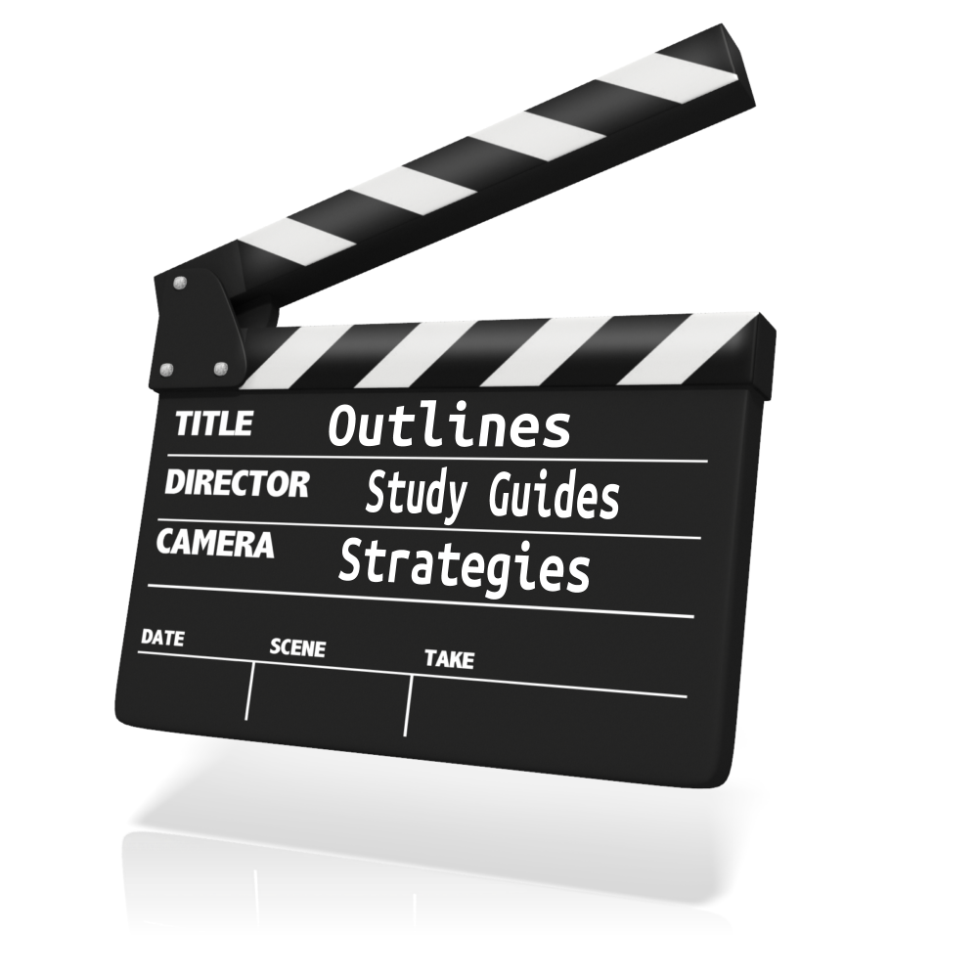
Reimagining the Textbook

Slide 7
Reimagining the Textbook

Slide 8
Reimagining the Textbook
Putting it All Together – Phase 3

Slide 9
Reimagining the Textbook

Slide 10
Reimagining the Textbook

Slide 11
Reimagining the Textbook

Slide 12
Reimagining the Textbook

Slide 13
Reimagining the Textbook

Slide 14
Reimagining the Textbook

Slide 15
Reimagining the Textbook

Slide 16
Reimagining the Textbook
Publishing the Guide – Phase 4

Slide 17
Reimagining the Textbook
Curriki.org
iBookstore
MERLOT

Slide 18
Reimagining the Textbook

Slide 19
Reimagining the Textbook

