Slide 1
Digital Publishing Tools and Workflow

Slide 2
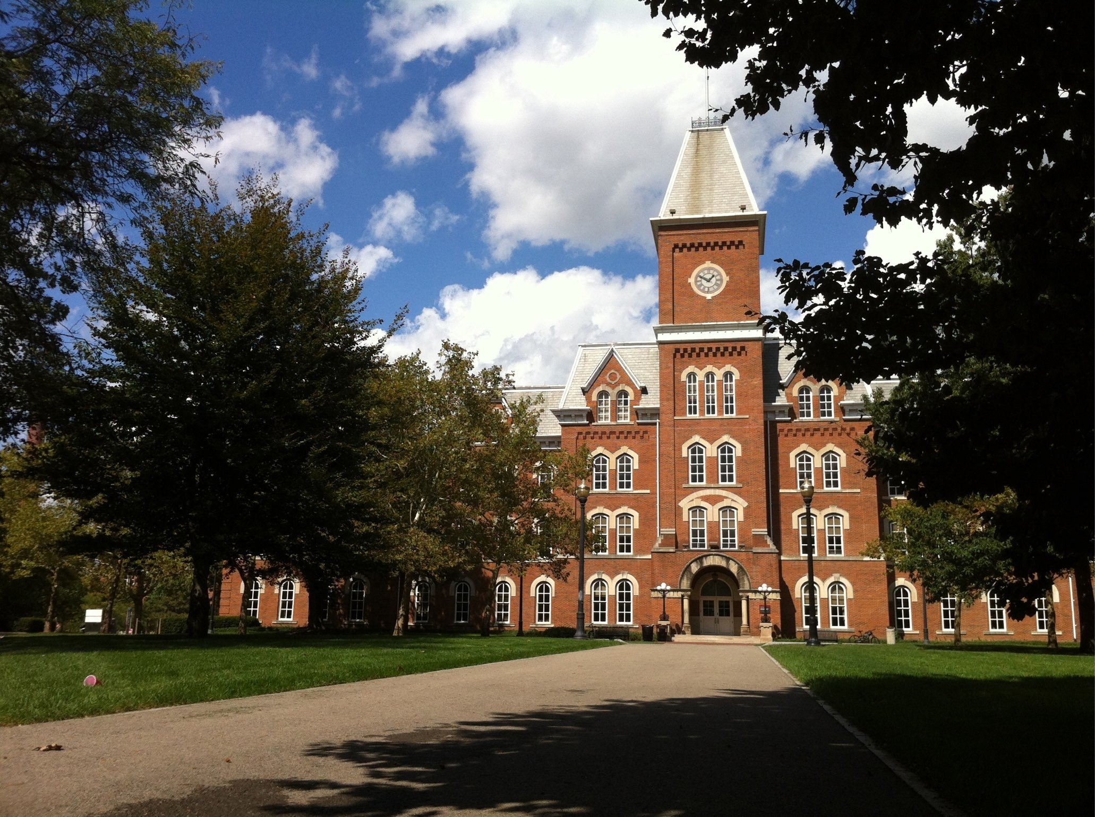
First things first: Workflow matters

Slide 3
Getting ready
Think of digital publishing tools as content aggregators, not authoring tools
Icons from the Noun Project licensed CC-BY-3.0 by (R-L) Mister Pixel, Edward Boatman, Jason Tropp

Slide 4
Getting ready
Where does authoring happen?
Word
iMovie
Explain Everything
Photoshop
With your ed tech team
Anywhere!

Slide 5
Getting ready
What you need, regardless of tools:
Outline
Text (final!)
Links
Images
Media
Glossary
Appendices

Slide 6
Consider: Content Transformation

Slide 7
Print v. Digital
Q: What is a digital book?
A: Not a book!
Notes:
University Libraries: To partner with others in ALX by providing services and information that will help instructors make their courses more affordable. This includes subject librarian expertise, copyright services and training, and purchasing of textbooks and other content.
Copyright Resource Center in the Library: provides education and support for all copyright-related questions. As part of the ALX initiative, we are available to help participants identify and comply with any copyright or licensing restrictions that may be in place on materials, in order to facilitate the adoption and creation of OER.
UCAT: UCAT is dedicated to helping teachers create learning experiences that allow students to grow intellectually and personally. We help teachers try to eliminate any barriers to those learning opportunities, and certainly having course material be accessible to all students is one of these. UCAT plays a valuable role in helping drive the ALX training and professional development strategy

Slide 8
New delivery = New thinking
Notes:
University Libraries: To partner with others in ALX by providing services and information that will help instructors make their courses more affordable. This includes subject librarian expertise, copyright services and training, and purchasing of textbooks and other content.
Copyright Resource Center in the Library: provides education and support for all copyright-related questions. As part of the ALX initiative, we are available to help participants identify and comply with any copyright or licensing restrictions that may be in place on materials, in order to facilitate the adoption and creation of OER.
UCAT: UCAT is dedicated to helping teachers create learning experiences that allow students to grow intellectually and personally. We help teachers try to eliminate any barriers to those learning opportunities, and certainly having course material be accessible to all students is one of these. UCAT plays a valuable role in helping drive the ALX training and professional development strategy

Slide 9
Tools
iBooks Author
Pressbooks
Open CNX
BookType
Blogs
Word/PDF
LMS
Notes:
University Libraries: To partner with others in ALX by providing services and information that will help instructors make their courses more affordable. This includes subject librarian expertise, copyright services and training, and purchasing of textbooks and other content.
Copyright Resource Center in the Library: provides education and support for all copyright-related questions. As part of the ALX initiative, we are available to help participants identify and comply with any copyright or licensing restrictions that may be in place on materials, in order to facilitate the adoption and creation of OER.
UCAT: UCAT is dedicated to helping teachers create learning experiences that allow students to grow intellectually and personally. We help teachers try to eliminate any barriers to those learning opportunities, and certainly having course material be accessible to all students is one of these. UCAT plays a valuable role in helping drive the ALX training and professional development strategy

Slide 10
Tools
Our choices:
Word/PDF
iBooks Author
Pressbooks
Notes:
University Libraries: To partner with others in ALX by providing services and information that will help instructors make their courses more affordable. This includes subject librarian expertise, copyright services and training, and purchasing of textbooks and other content.
Copyright Resource Center in the Library: provides education and support for all copyright-related questions. As part of the ALX initiative, we are available to help participants identify and comply with any copyright or licensing restrictions that may be in place on materials, in order to facilitate the adoption and creation of OER.
UCAT: UCAT is dedicated to helping teachers create learning experiences that allow students to grow intellectually and personally. We help teachers try to eliminate any barriers to those learning opportunities, and certainly having course material be accessible to all students is one of these. UCAT plays a valuable role in helping drive the ALX training and professional development strategy

Slide 11
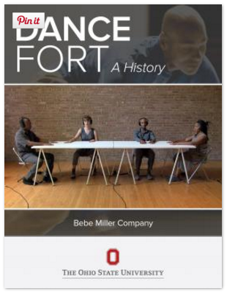
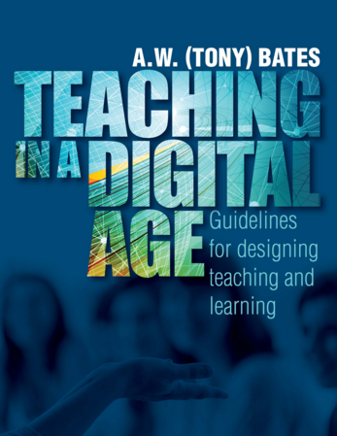
Examples
Notes:
University Libraries: To partner with others in ALX by providing services and information that will help instructors make their courses more affordable. This includes subject librarian expertise, copyright services and training, and purchasing of textbooks and other content.
Copyright Resource Center in the Library: provides education and support for all copyright-related questions. As part of the ALX initiative, we are available to help participants identify and comply with any copyright or licensing restrictions that may be in place on materials, in order to facilitate the adoption and creation of OER.
UCAT: UCAT is dedicated to helping teachers create learning experiences that allow students to grow intellectually and personally. We help teachers try to eliminate any barriers to those learning opportunities, and certainly having course material be accessible to all students is one of these. UCAT plays a valuable role in helping drive the ALX training and professional development strategy

Slide 12
What are your challenges and next steps?

Slide 13
Thank you
Affordable Learning Exchange
affordablelearningexchange.osu.edu

